Slide 1
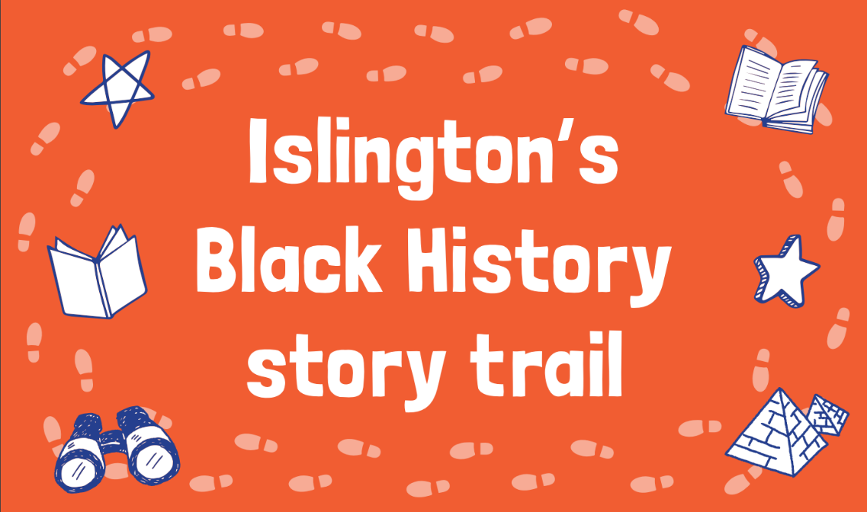

Slide 2

Welcome explorers!
I’m Avril. Me and my friends at Get Islington Reading are very excited to have you join us on our adventure around Islington!
Did you know that in Islington you can discover stories and voices from all over the world, including Ancient Egypt, Africa and India?
Have fun finding and meeting freedom fighters, singers, explorers, dancers, and other inspiring characters from Black history on our trail around the borough.

Slide 3
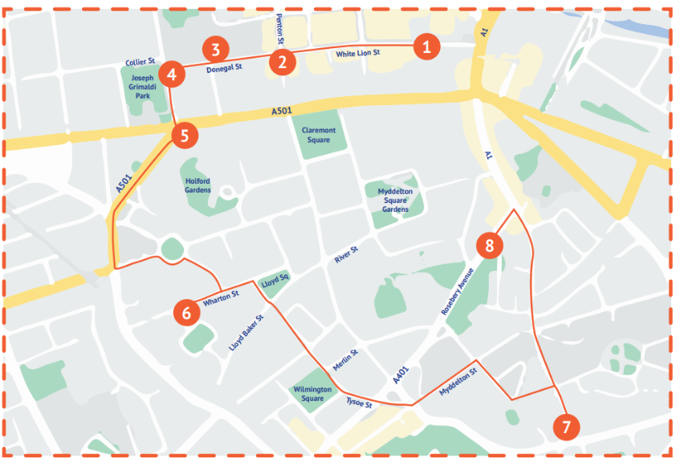

Slide 4
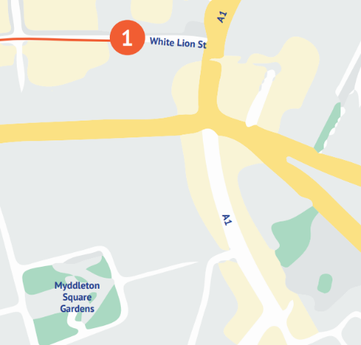

Our journey starts on White Lion Street, opposite Angel tube station.
Angel tube station

Slide 5

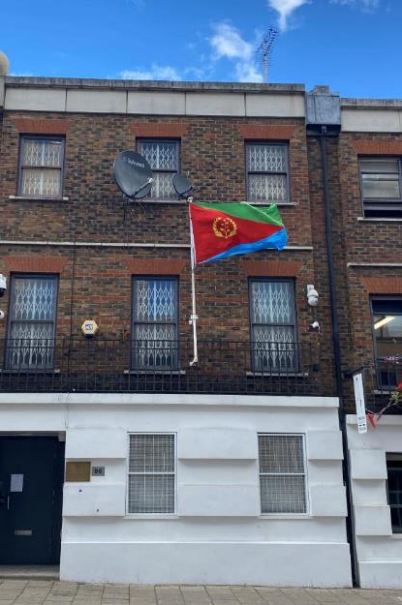
1
Can you guess the name of the African country from the flag outside this building?
This is the Eritrean Embassy.
An embassy is where an ambassador works to build relationships between their country and the rest of the world.
Notes:
Here you could explore with your pupils what the importance of an embassy is, asking why they are important and why you would visit an embassy.

Slide 6
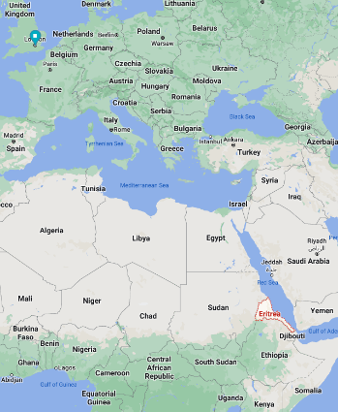

Eritrea is a country in Eastern Africa.
It’s the birthplace of Italian poet Ribka Sibhatu.
Who might Sibhatu have written this poem for? Are there clues in the language she uses?
What does it mean to ‘feel not at home’? Have you ever felt like this?
What is it about the moon that offers comfort and helps us to feel at home?
What offers you comfort when you feel ‘not at home’ or in a ‘strange land’?
Grandmother Moon
Like once upon a time
here comes grandmother moon
through the window
full of tales and memories.
Be brave, little one,
I'll keep you company
wherever you are!
Grandmother moon
tells stories and sings poems
that make us feel
at home in a strange land!
By Ribka Sibhatu
translated by André Naffis-Sahely
Notes:
Like 'Word’, this is another charming poem written by Ribka for her daughter to make her 'feel at home in a strange land'. Here, she invokes the comforting feminine presence of the moon, whose familiarity provides a sense of continuity in a changed world. The opening line of the poem, 'Like once upon a time’, immediately indicates this is a poem for a child, and its delicate simplicity was a real pleasure to translate.

Slide 7
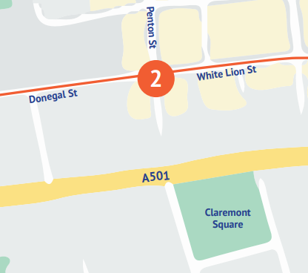
Next, we will head along White Lion Street to reach Donegal Street.

Slide 8
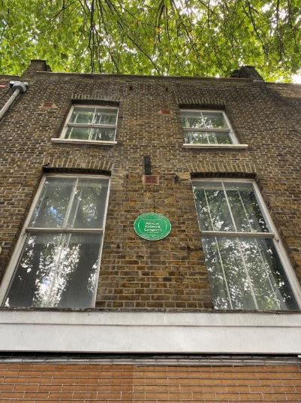
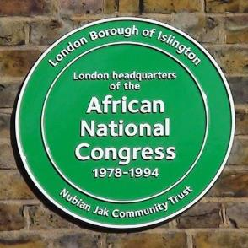
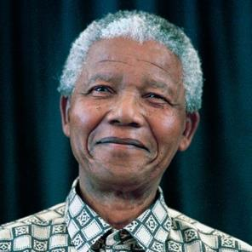
2
This was the African National Congress HQ from the 1970s to 1990s. Here, activists worked to worked to free political prisoners like Nelson Mandela and to fight for Black South African rights.
What do you know about Nelson Mandela?
Why is he an important person in history?
Notes:
Find a biography of Nelson Mandela here: https://www.nelsonmandela.org/content/page/biography

Slide 9
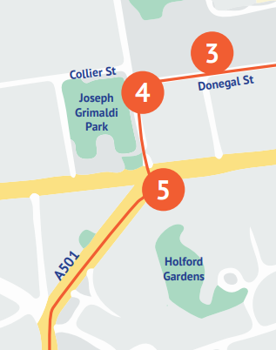
Let’s head to the end of Donegal Street and onto Rodney Street for points 3, 4 and 5 on the map!

Slide 10
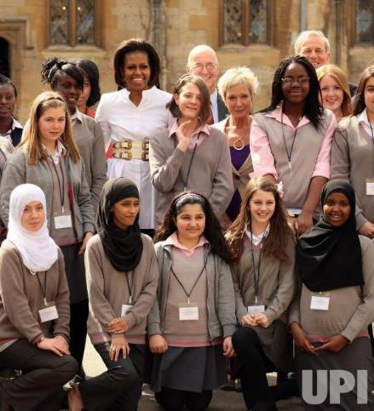
3
On Donegal Street, you will spot Elizabeth Garett Anderson School.
This school has been visited twice by a lady who was married to the first African American President of the USA. Can you guess who it is?
Over 50 languages are spoken by pupils at EGA. The First Lady said that their multilingualism and ability to adapt to different cultures means that they are ‘full of courage’.

Slide 11
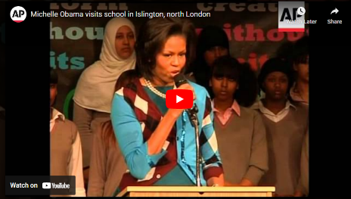
Watch this speech from Michelle Obama.
Speeches often include:
Stories or anecdotes, e.g. “I remember when…”
Lists of three, e.g. “Michelle is brave, strong, and kind.”
An inspiring final line that packs a punch
Rhetorical questions
Who is an inspiring woman in your life? It could be a friend or family member, someone famous or someone from history.
Write a speech to your class about this person and how they have inspired you.

Slide 12
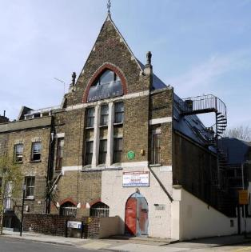
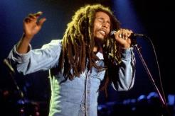
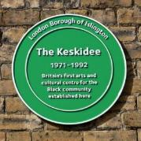
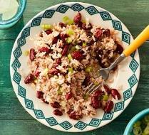
4
If you walked 15 minutes to the North West, you would discover the Keskidee Centre where Bob Marley filmed Is This Love?
It was the Black community’s first arts centre in the UK and popular for AfroCaribbean art, but was destroyed in a fire in 2012.
The Keskidee Centre also taught cooking, painting and literacy classes.
Check out this recipe for rice and peas, a classic dish from Jamaica, Bob Marley’s home country: https://www.bbcgoodfood.com/recipes/rice-and-peas
If you were to pass on a favourite family recipe, what would it be? Try writing your own recipe.

Slide 13
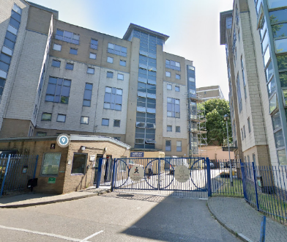
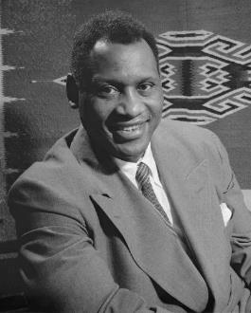
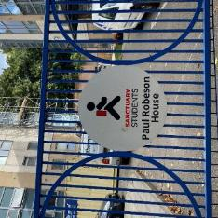
5
This building is student rooms for The School of Oriental and African Studies.
It’s named after singer, actor and activist Paul Robeson.
He was the first Black person to star as Othello in the Shakespeare play since 1860, could sing in 20 languages, and played a big part in the civil rights movement.
Do you know any songs in other languages? Teach them to each other!
Listen to Paul Robeson sing Amazing Grace here
Notes:
Find out more about Paul Robeson here: https://www.britannica.com/biography/Paul-Robeson

Slide 14
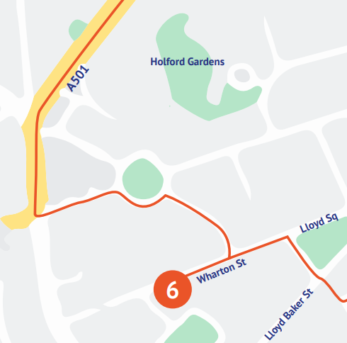
Now we will venture down Penton Rise, and round Percy Circus. Our next stop is on Wharton street.

Slide 15
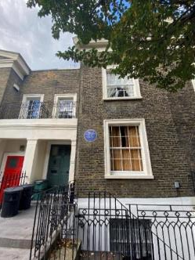
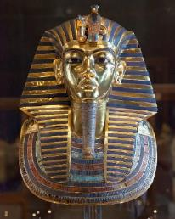
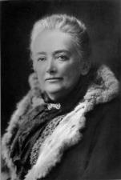
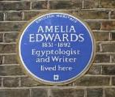
6
Did you know there’s a bit of Egypt in Islington? Amelia Edwards was an Egyptologist in the 1800s, which means she studied Ancient Egyptian history and campaigned to preserve ancient monuments.
She set up the Egypt Exploration Fund, which discovered the most famous Egyptian Mummy and King.
Ancient Egyptians were buried with their most precious items like jewellery, food and clothing, to help their journey to the afterlife. If you could pick three special items or books to go inside your tomb, what would they be? Draw them and label them.
Notes:
You could have a discussion with your pupils about why Amelia Edwards campaigned to preserve ancient monuments. What significance do they have? Why are they important? etc

Slide 16
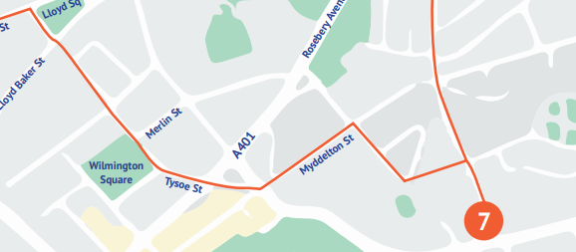
Wind your way to Finsbury Library and Islington Museum...

Slide 17
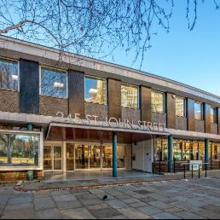
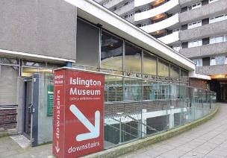
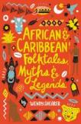
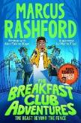
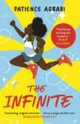

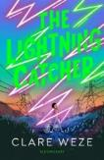
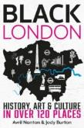
At the library, you will find hundreds of fantastic books written by Black authors and featuring Black characters on amazing adventures...
Next door to the library is Islington Museum, where you can learn more about Islington’s past and the people who are part of the community to this day.
What books have you read by Black authors or featuring Black characters?
Some of our favourites are below!
7

Slide 18
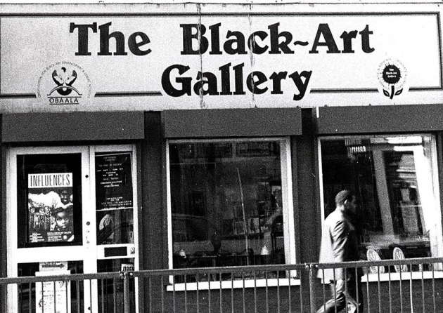
One of the places you can learn about at Islington Museum is The Black-Art Gallery.
This gallery was opened near Finsbury Park in the 1980s, and helped Black people see themselves in art.
Why is it important to see yourself reflected in art?
You can read more about The Black-Art Gallery on the Islington Gazette website here.

Slide 19
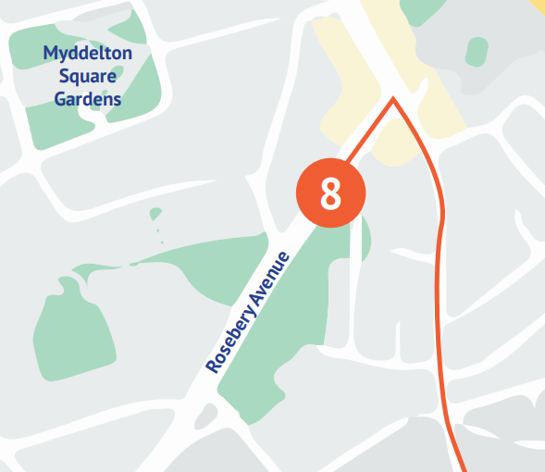
Our final stop is Sadler’s Wells Theatre on Rosebery Avenue.

Slide 20

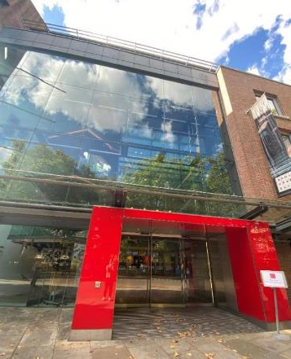
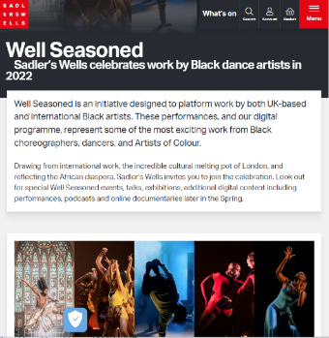
6
Sadler’s Wells Theatre is a performing arts venue famous for dance and ballet shows.
Visit the Well Seasoned online platform and watch some of the ‘most exciting work from Black choreographers, dancers, and Artists of Colour’.

Slide 21
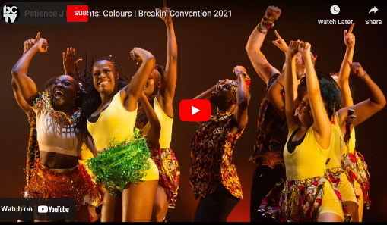
Watch this performance from dance crew Patience J, performing at the Breakin’ Convention hip hop festival, Sadler’s Wells.
This performance is called Colours, and is a celebratory piece exploring modern Afro dance forms called n’dombolo and azonto.
Write down:
Three adjectives describing the way the dancers move on stage
Three adjectives describing the music
Three adjectives describing how the performance makes you feel
You could weave these words into your own review of the production!

Slide 22

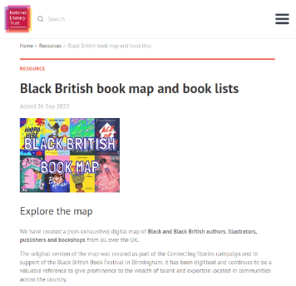
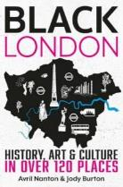
Thanks for joining us!
We hope you enjoyed learning a bit about the Black history of Islington.
Black culture and stories should be celebrated all year round!
If you enjoyed this trail, check out some of the National Literacy Trust’s fantastic free booklists and the Black British book map.
You can also check out my book Black London, for more inspiring Black history, art and culture across our amazing city!

