Slide 2
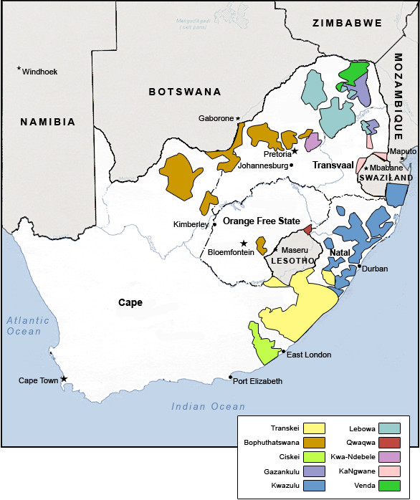
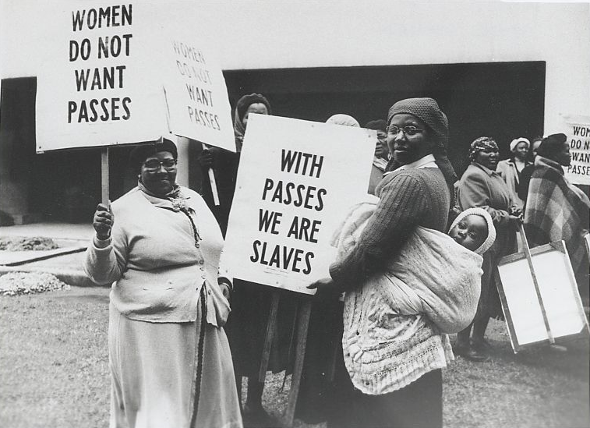
Women’s Experiences During Apartheid
“Reserves”, “Homelands” and “Bantustans”
Rural areas vs urban centres
Pass Laws
Gendered labour policies
Control
Image links:
South Africa: Overcoming Apartheid (msu.edu)
Women Rise Up Against Apartheid and Change the Movement | Facing History and Ourselves

Slide 3
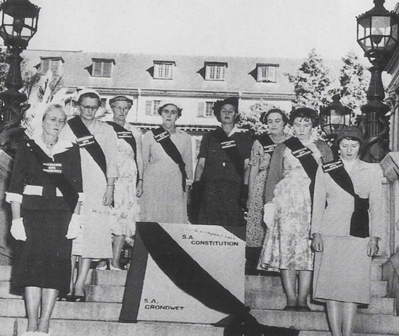
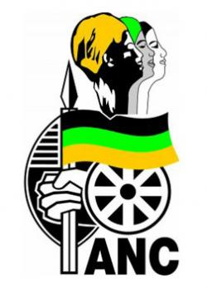
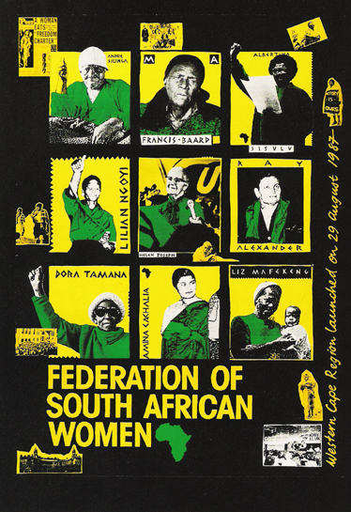
Groups
Federation of South African Women (FEDSAW)
ANC Women’s League
The Black Sash (formerly The Women’s Defense of The Constitution League)
Image links:
ANC Women’s League (ANCWL) | South African History Online (sahistory.org.za)
The Black Sash: A History of Transformation | South African History Online (sahistory.org.za)
South Africa: Overcoming Apartheid (msu.edu)

Slide 4
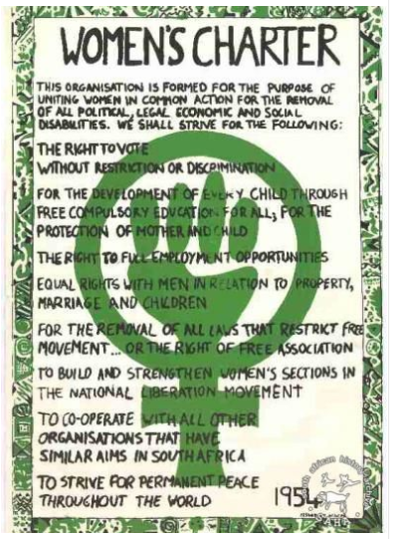
The 1954 Women’s Charter
Adopted at the Founding Conference of the Federation of South African Women in April 1954, the charter expressed the philosophy and aims of FSAW and was adopted unanimously.
Preamble:
We, the women of South Africa, wives and mothers, working women and housewives, African, Indians, European and Coloured, hereby declare our aim of striving for the removal of all laws, regulations, conventions and customs that discriminate against us as women, and that deprive us in any way of our inherent right to the advantages, responsibilities and opportunities that society offers to any one section of the population.
Image:
Nicholas Wolpe on LinkedIn: #saveliliesleaf #nationalheritage #liliesleaf

Slide 5
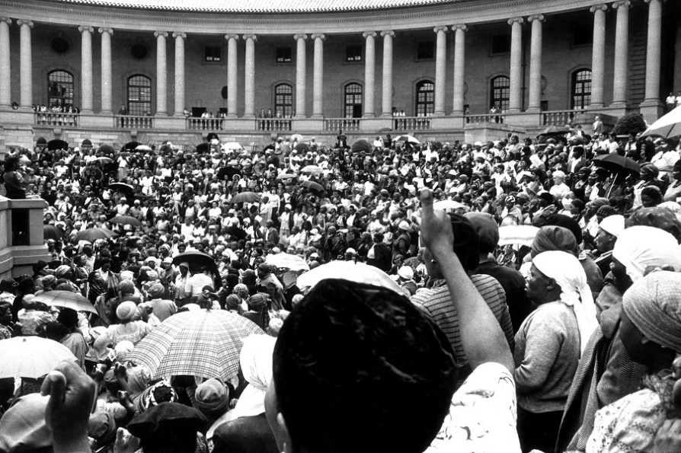
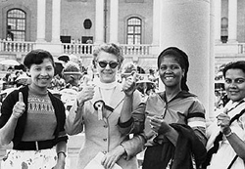
The 1956 Women’s March on Pretoria
On the 9th August 1956, over 20,000 women from all backgrounds and cultures including Indians, Coloureds, Whites, and Blacks held a march on the Union Buildings of Pretoria to protest against the pass laws.
The 1956 Women’s March played a vital role in the women becoming more visible participants in the anti-apartheid struggle.
The march led to the rise of several strong female leaders in the struggle against apartheid, and increased the presence of women in mass media that called upon the march to inspire others.
Image links:
20,000 Women march to the Union Buildings in protest of pass laws | South African History Online (sahistory.org.za)
The 1956 Women’s March in Pretoria | South African History Online (sahistory.org.za)

Slide 6
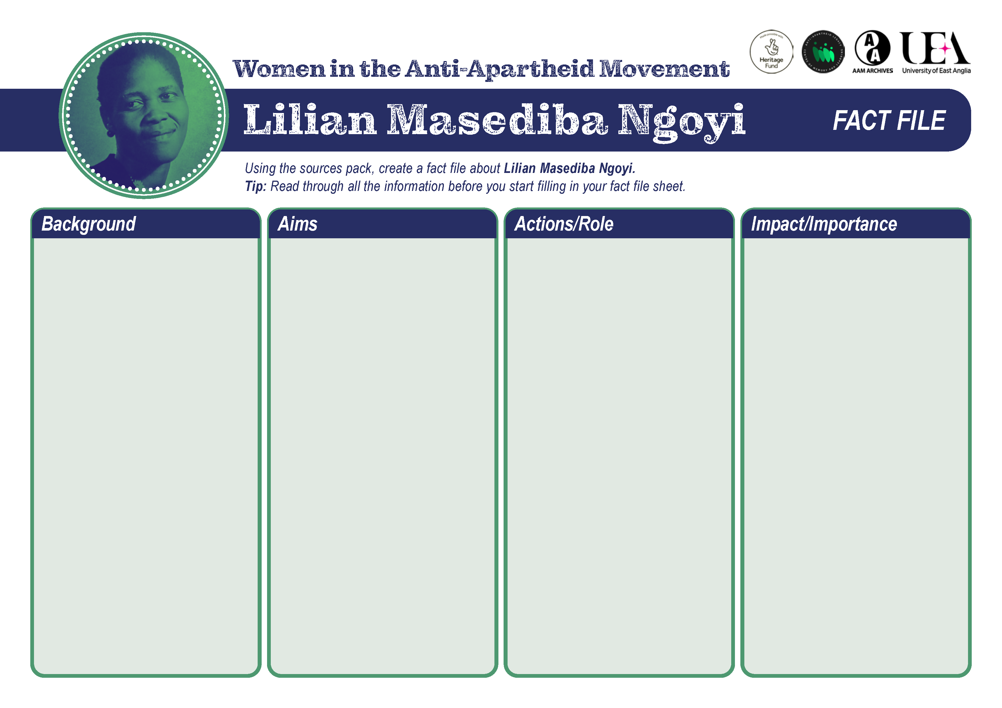
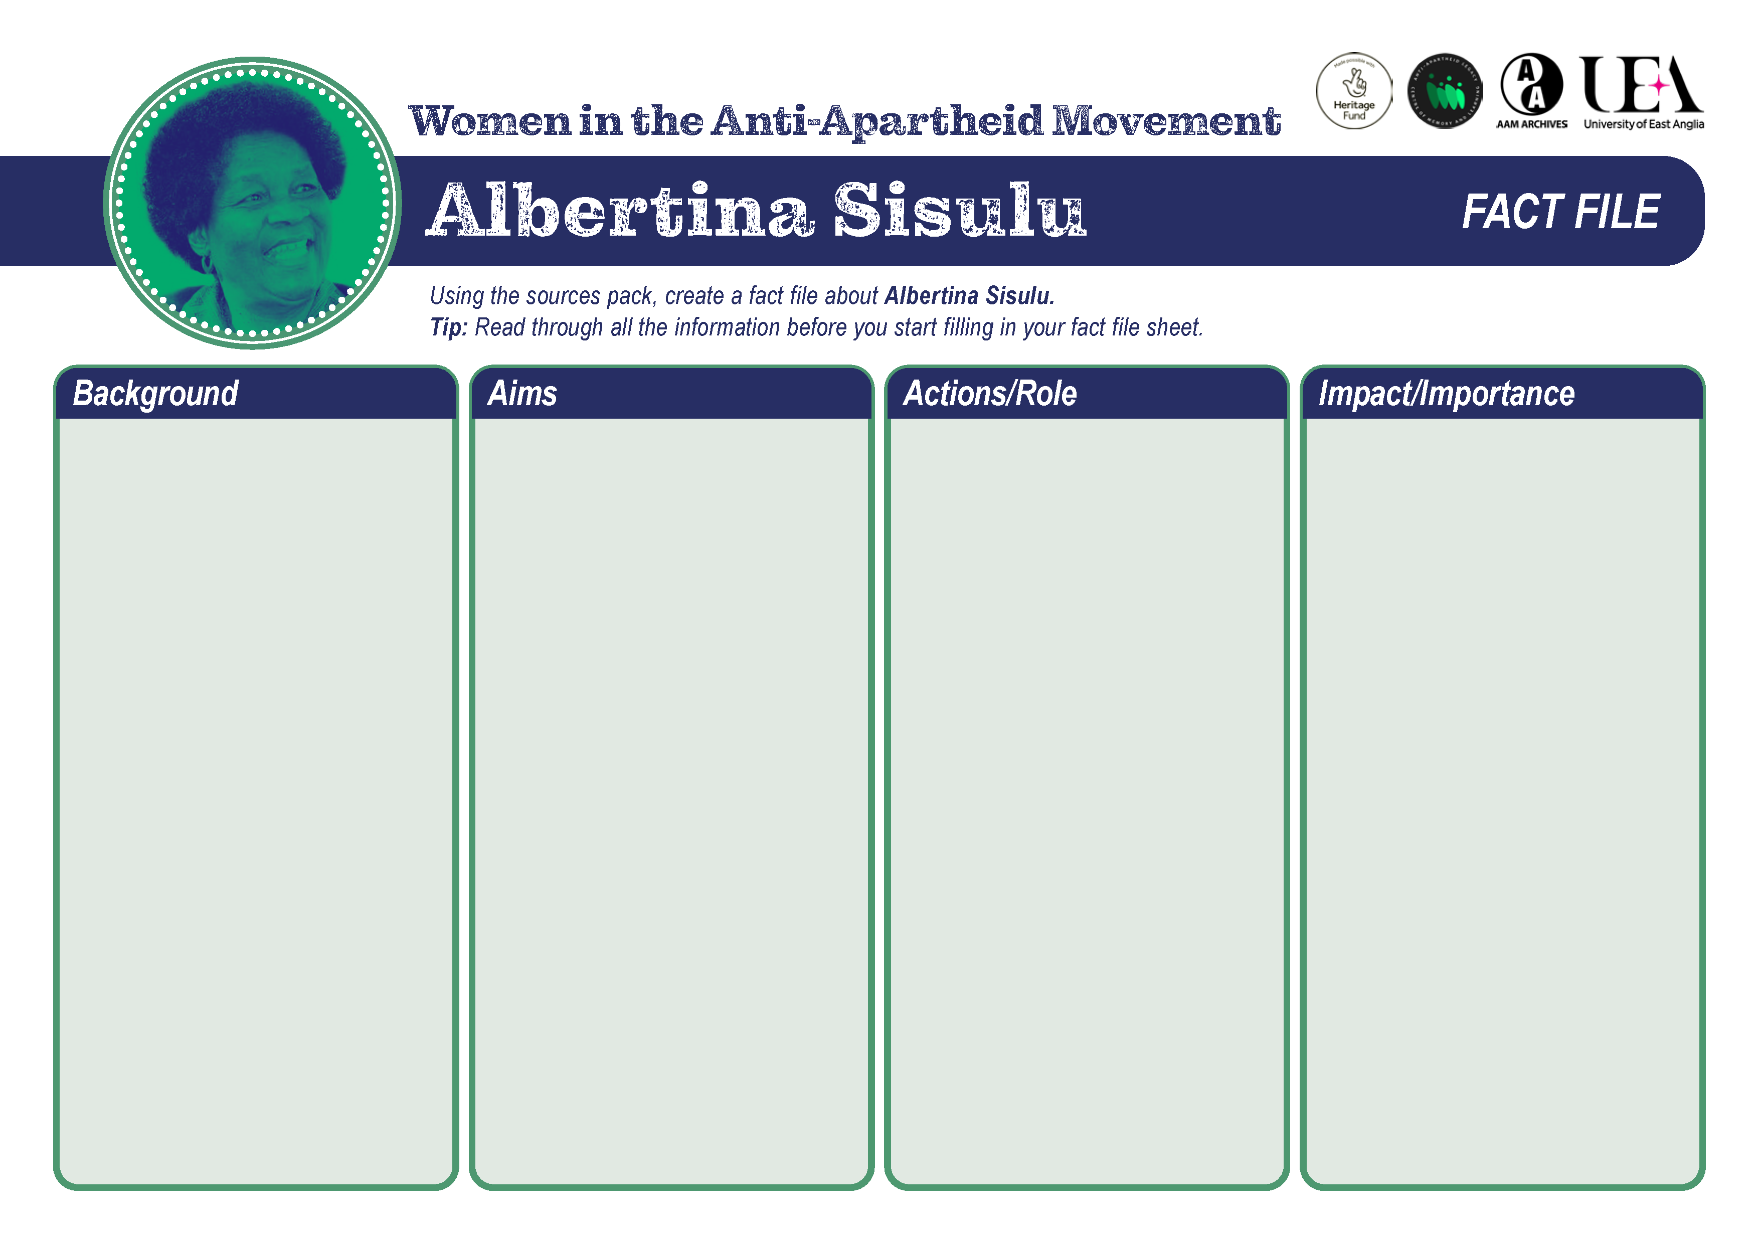
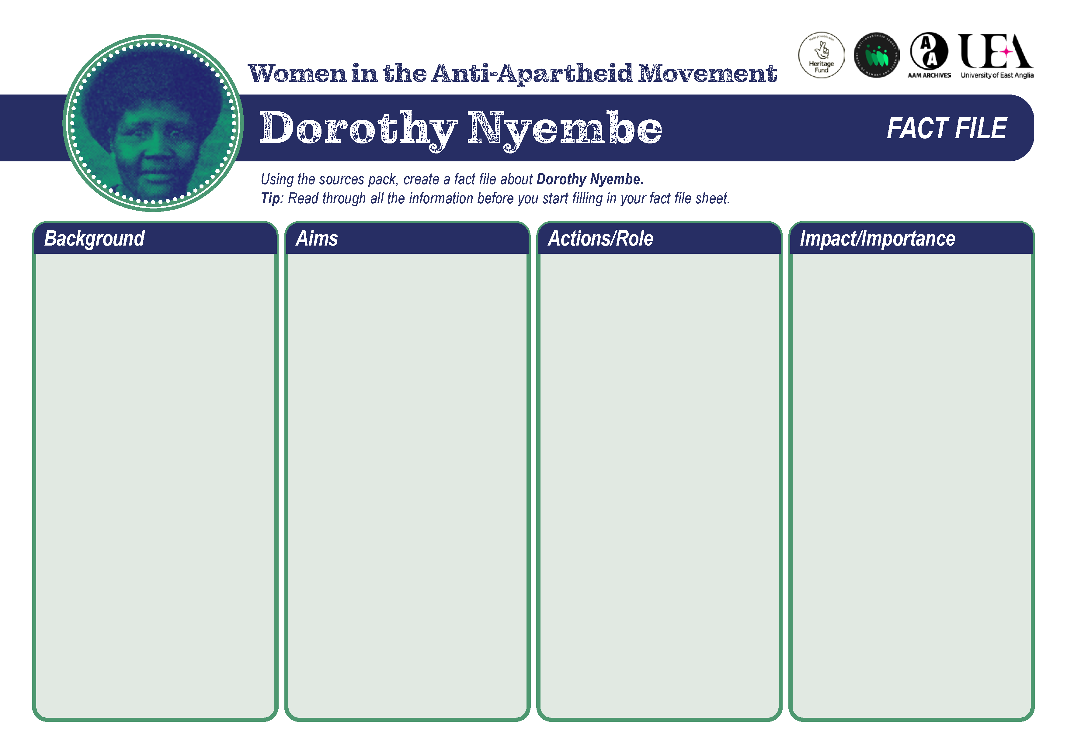
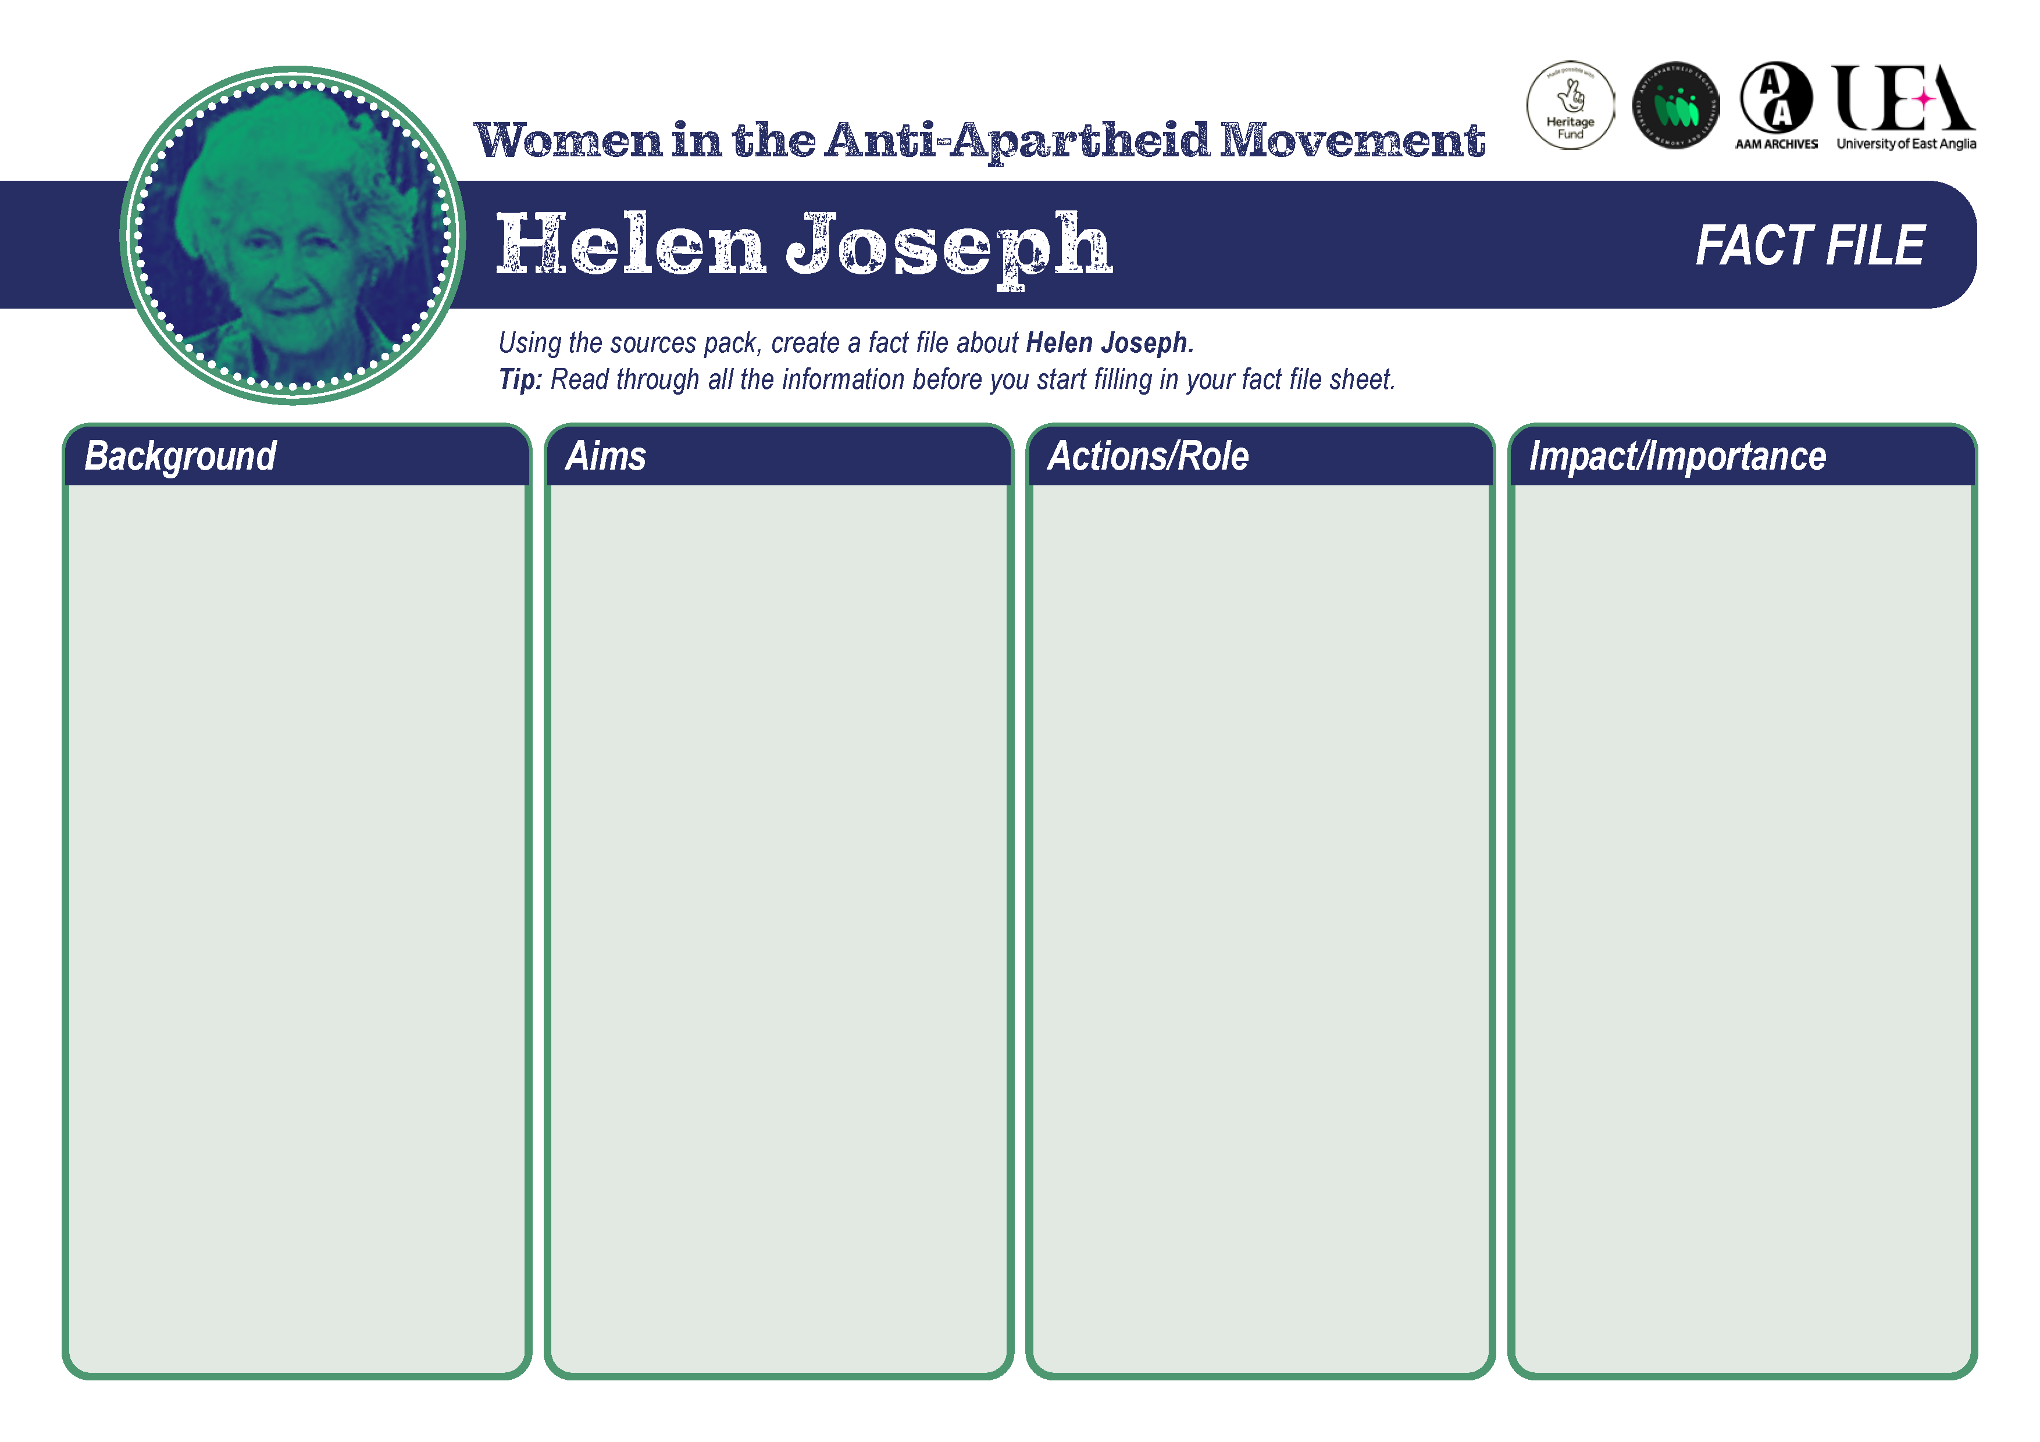
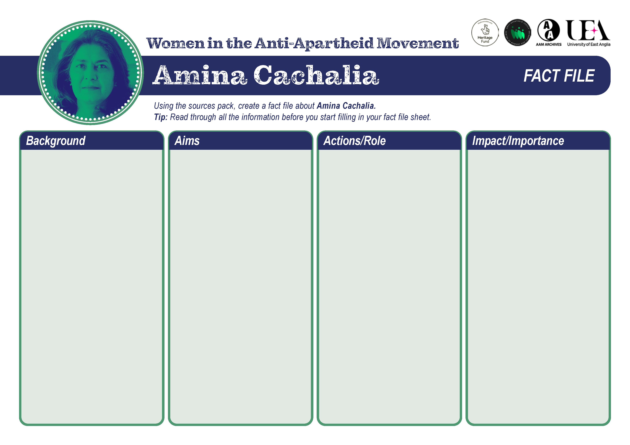
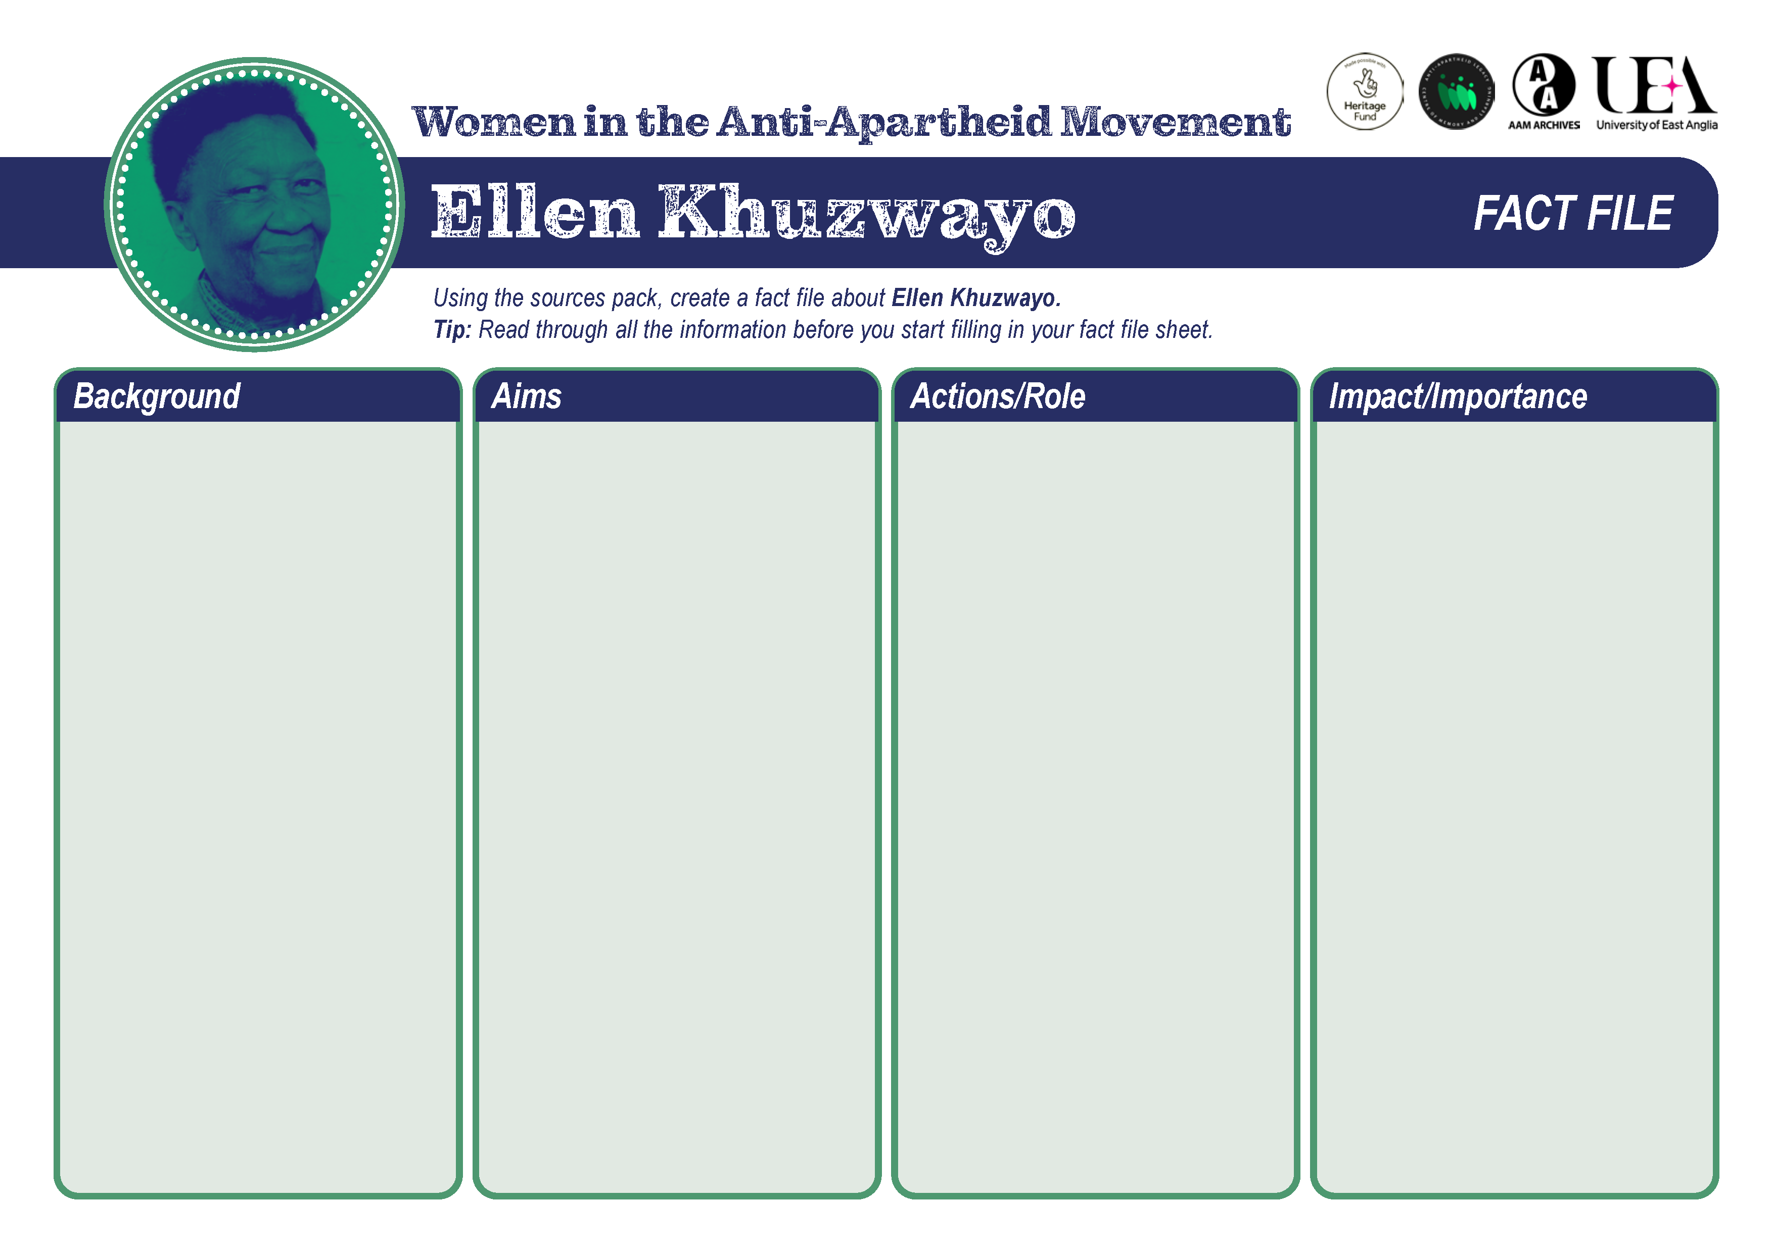
Fact File
Using the resource files in this pack, create a fact file about your chosen individual.
Tip: Read through all the information before you start filling in your fact file sheet.

Slide 7
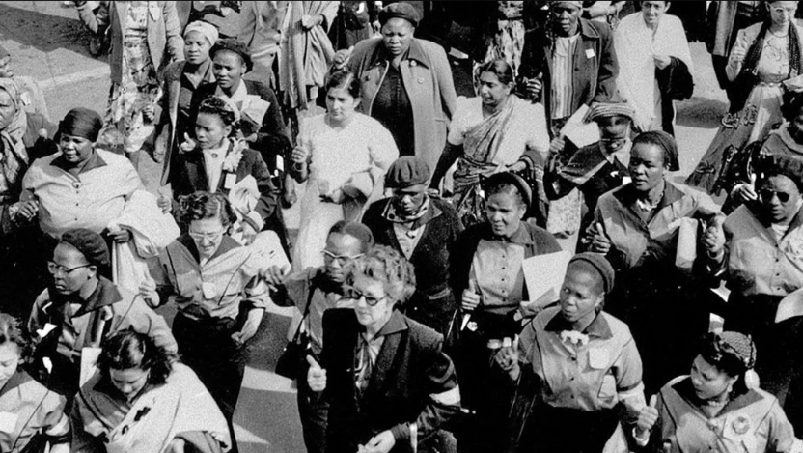
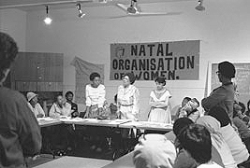
Group Discussion
What have you learned today that you did not know before?
Has this session changed how you think about apartheid or the anti-apartheid movement?
Why were women central to the anti-apartheid movement?
Why do you think their contributions have been overlooked until more recently?
How relevant are these struggles and issues for women in South Africa today?
Image links:
Women's March 1956 02 | South African History Online (sahistory.org.za)
Mrs Sisulu (centre) and executive members of the Natal Organisation of Women at the launch of NOW | South African History Online (sahistory.org.za)

Slide 8
The University of East Anglia is a globally significant centre of research that drives global change. We bring fresh thinking to the major challenges facing society, helping to create a better future for all.
About This Resource
The Anti Apartheid Legacy: Centre of Memory and Learning promotes the legacy and values of the Southern African liberation struggle and the UK’s central role within this world-changing history, whilst supporting contemporary discourse around social (in)justice, inclusion and multi-racial collaboration for social transformation.
This presentation is part of a resource collaboratively developed by The Anti-Apartheid Legacy: Centre of Memory and Learning (CML) and UEA. It is part of the CML’s work to promote the legacy and values of the Southern African liberation struggle, whilst supporting contemporary discourse around social (in)justice, inclusion and multi-racial collaboration for social transformation
Many of the images and linked documents are supplied with kind permission of project partners, The Anti-Apartheid Movement Archives. Other sources are referred to at the relevant places in the packs.
The development of the resources has been made possible with generous support from the National Lottery Heritage Fund and UEA’s Impact Fund.
The Anti Apartheid Movement Archives Forward to Freedom tells the story of the British Anti-Apartheid Movement and its campaigns to support the people of South Africa in their fight against apartheid.
The National Lottery Heritage Fund As the largest dedicated funder of the UK’s heritage, The National Lottery Heritage Fund’s vision is for heritage to be valued, cared for and sustained for everyone, now and in the future.

