Slide 2
Exile
What comes to your mind when you think of the word ‘exile’?
Why were some people exiled from South Africa during apartheid?
The South African exile experience is uniquely different. Exile was neither the aftermath of a lost war nor of a defeated coup or revolution… Those political activists who went into exile saw themselves as part of a continuing and rising struggle at home
The Rift: Exile Experience of South Africans
By Hilda Bernstein, p. xvi

Slide 3
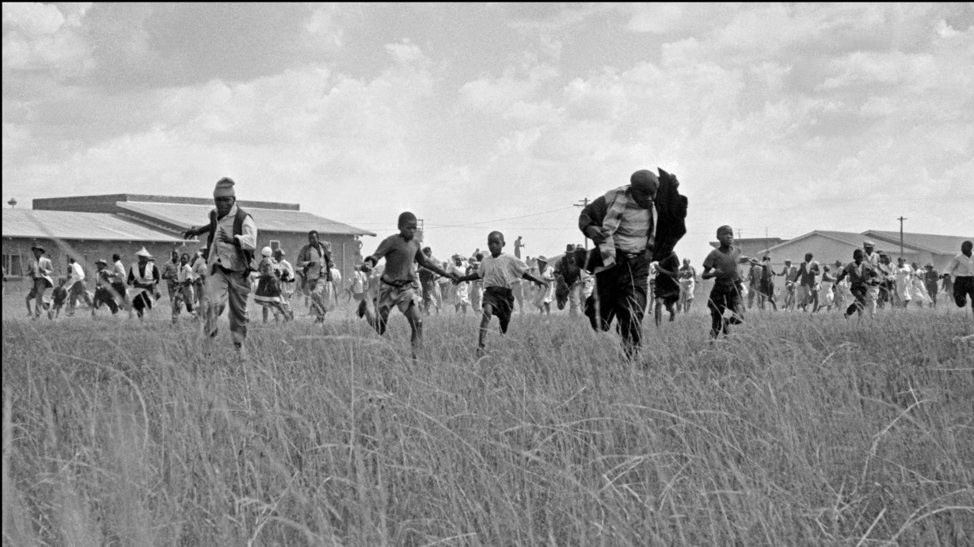
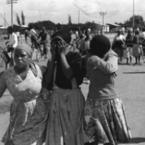
Sharpeville Massacre 1960
On 21st March 1960 the Pan Africanist Congress (PAC) organised a countrywide demonstration for the abolition of South Africa’s pass laws. They called on black South Africans to leave their passbooks at home, peacefully gather at their nearest police station and demand that the police arrest them for not carrying passes.
Thousands of South Africans marched to the Sharpeville police station and gathered peacefully. They chanted freedom songs and shouted, “Down with passes!”
Police and armoured vehicles began to gather and, according to police, after a small scuffle protesters began to stone them. Without warning the police opened fire on the crowd.
According to the official inquest, 69 people were shot dead and 180 people seriously wounded.
Image links:
Sharpeville Massacre, 21 March 1960 | South African History Online (sahistory.org.za)
State of emergency declared after Sharpeville Massacre | South African History Online (sahistory.org.za)

Slide 4
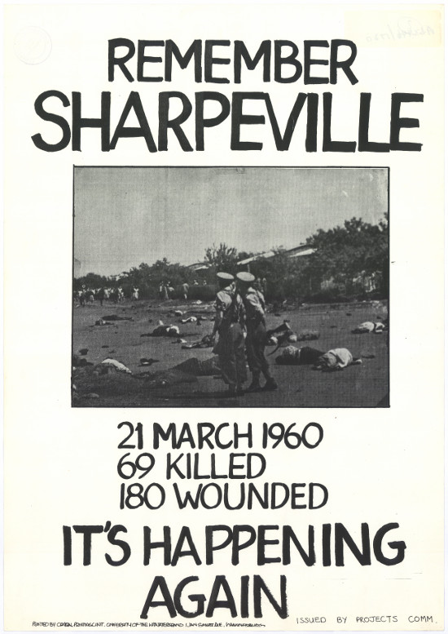
Exile
The Sharpeville massacre sent shock waves around the country and the world and served as a catalyst for some individuals going into exile.
In April 1960 the Government passed the Unlawful Organisations Act, banning the ANC and the PAC, and making it illegal to be a member of these organizations. The State also banned leading political figures.
The government declared a state of emergency and by early May 18,000 people were detained under in 83 magisterial districts.
Groups such as the ANC, PAC, South African Communist Party (SACP) and the South African Congress of Trade Unions (SACTU) sent members abroad to mobilise international support against the Apartheid regime. Many other members went underground.
Oppression continued and took many forms. As a result of this, exile was a continuing process and people left for different reasons and as a result of different events (e.g. the Soweto uprising).
Leaders abroad established the infrastructure and support bases for military training of members who they hoped to send back to South Africa, but many spent years in exile.
Image link:
Poster commemorating Sharpeville 3 | South African History Online (sahistory.org.za)

Slide 5
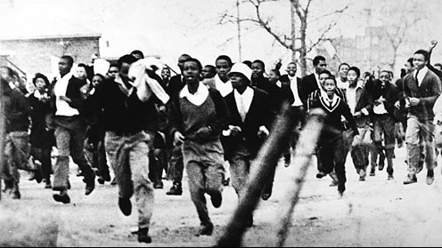
Soweto Uprising
Police forces tried to turn the students back using tear gas and warning shots, they then began firing into the crowd. Many students ran for cover whilst others retaliated by throwing stones at the police.
Two students died from gunfire and hundreds more were injured. The shootings in Soweto sparked a massive uprising that soon spread to more than 100 urban and rural areas throughout South Africa.
By late 1977, the uprising had been quelled by the state. Over 1,000 people were dead. Large numbers of student activists were detained, imprisoned or driven into exile.
Image link:
June 16 Soweto Youth Uprising timeline: 1976-1986 | South African History Online (sahistory.org.za)

Slide 6
Exile
Estimated 60,000 exiles – exact number not known
Scattered throughout the world
Left by different routes – crossing borders, without passports and papers, exit permits
Organisations like the ANC became surrogate home/family/community for some.

Slide 7
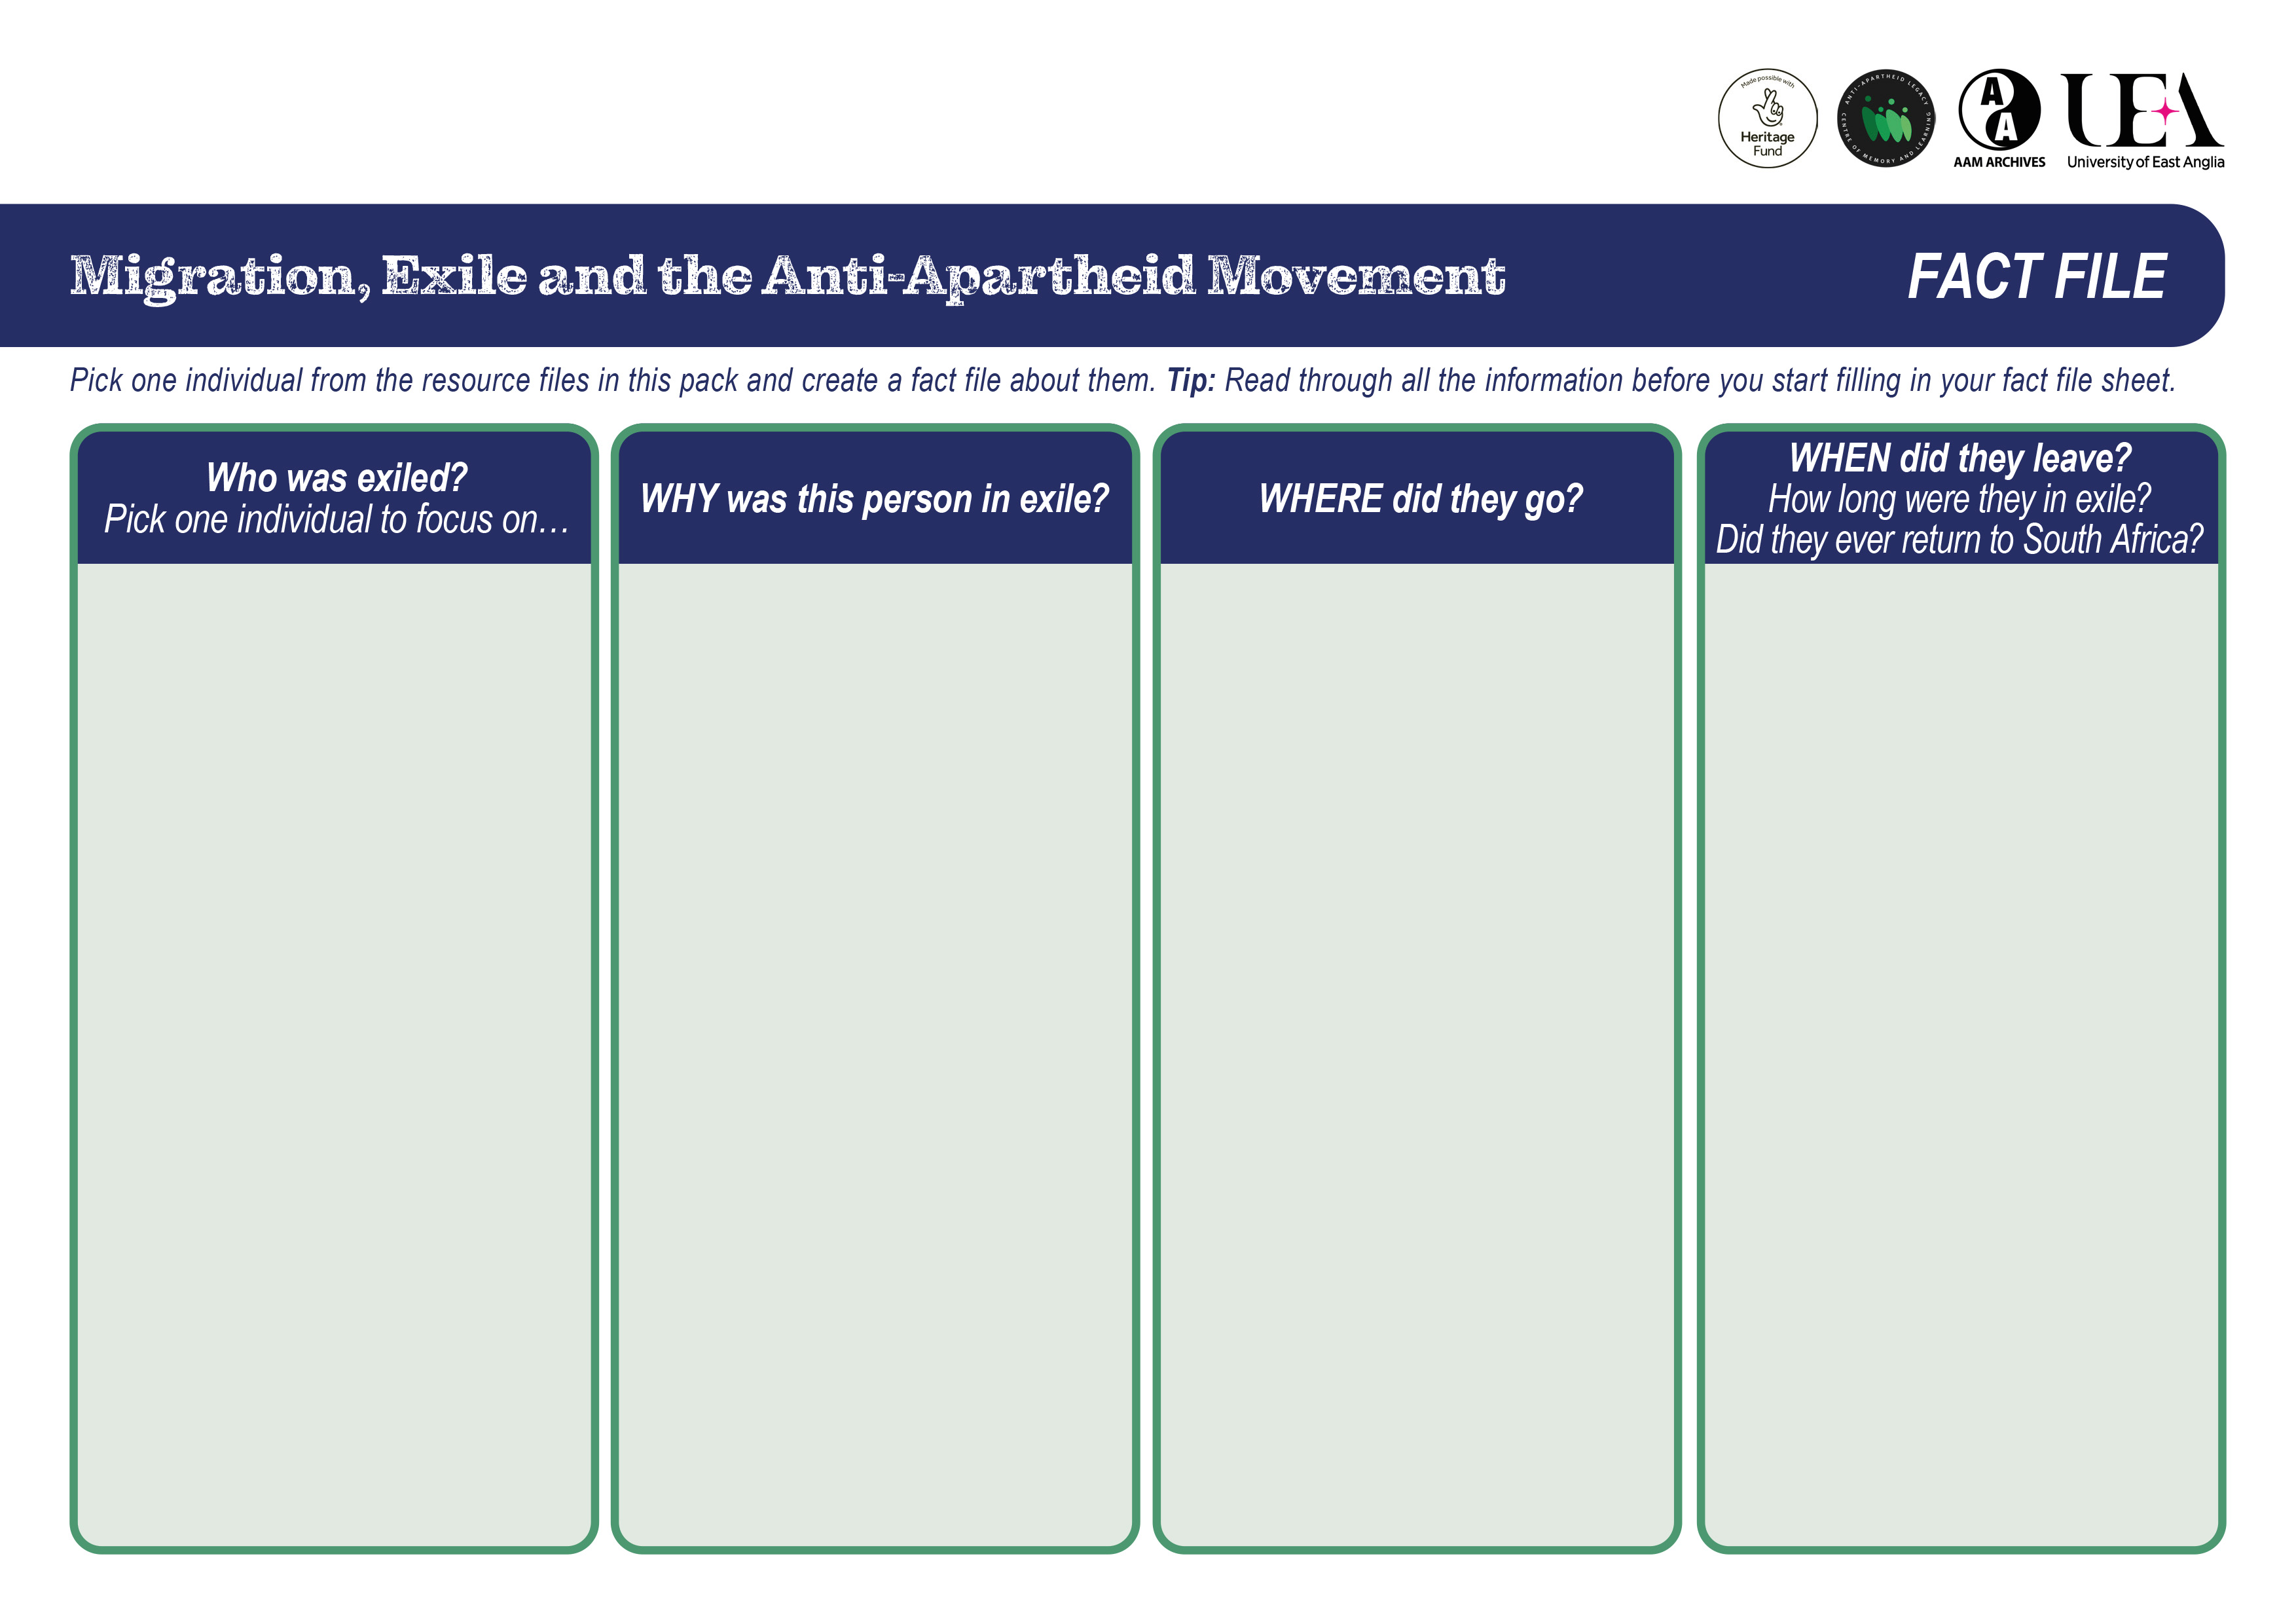
Activity
In groups of up to 3 pick one individual each from the Resource Files.
In your group, share and discuss the experiences and work of your chosen individual, then fill in a Fact File.
Tip: Read through all the information before you start filling in your fact file sheet.

Slide 8
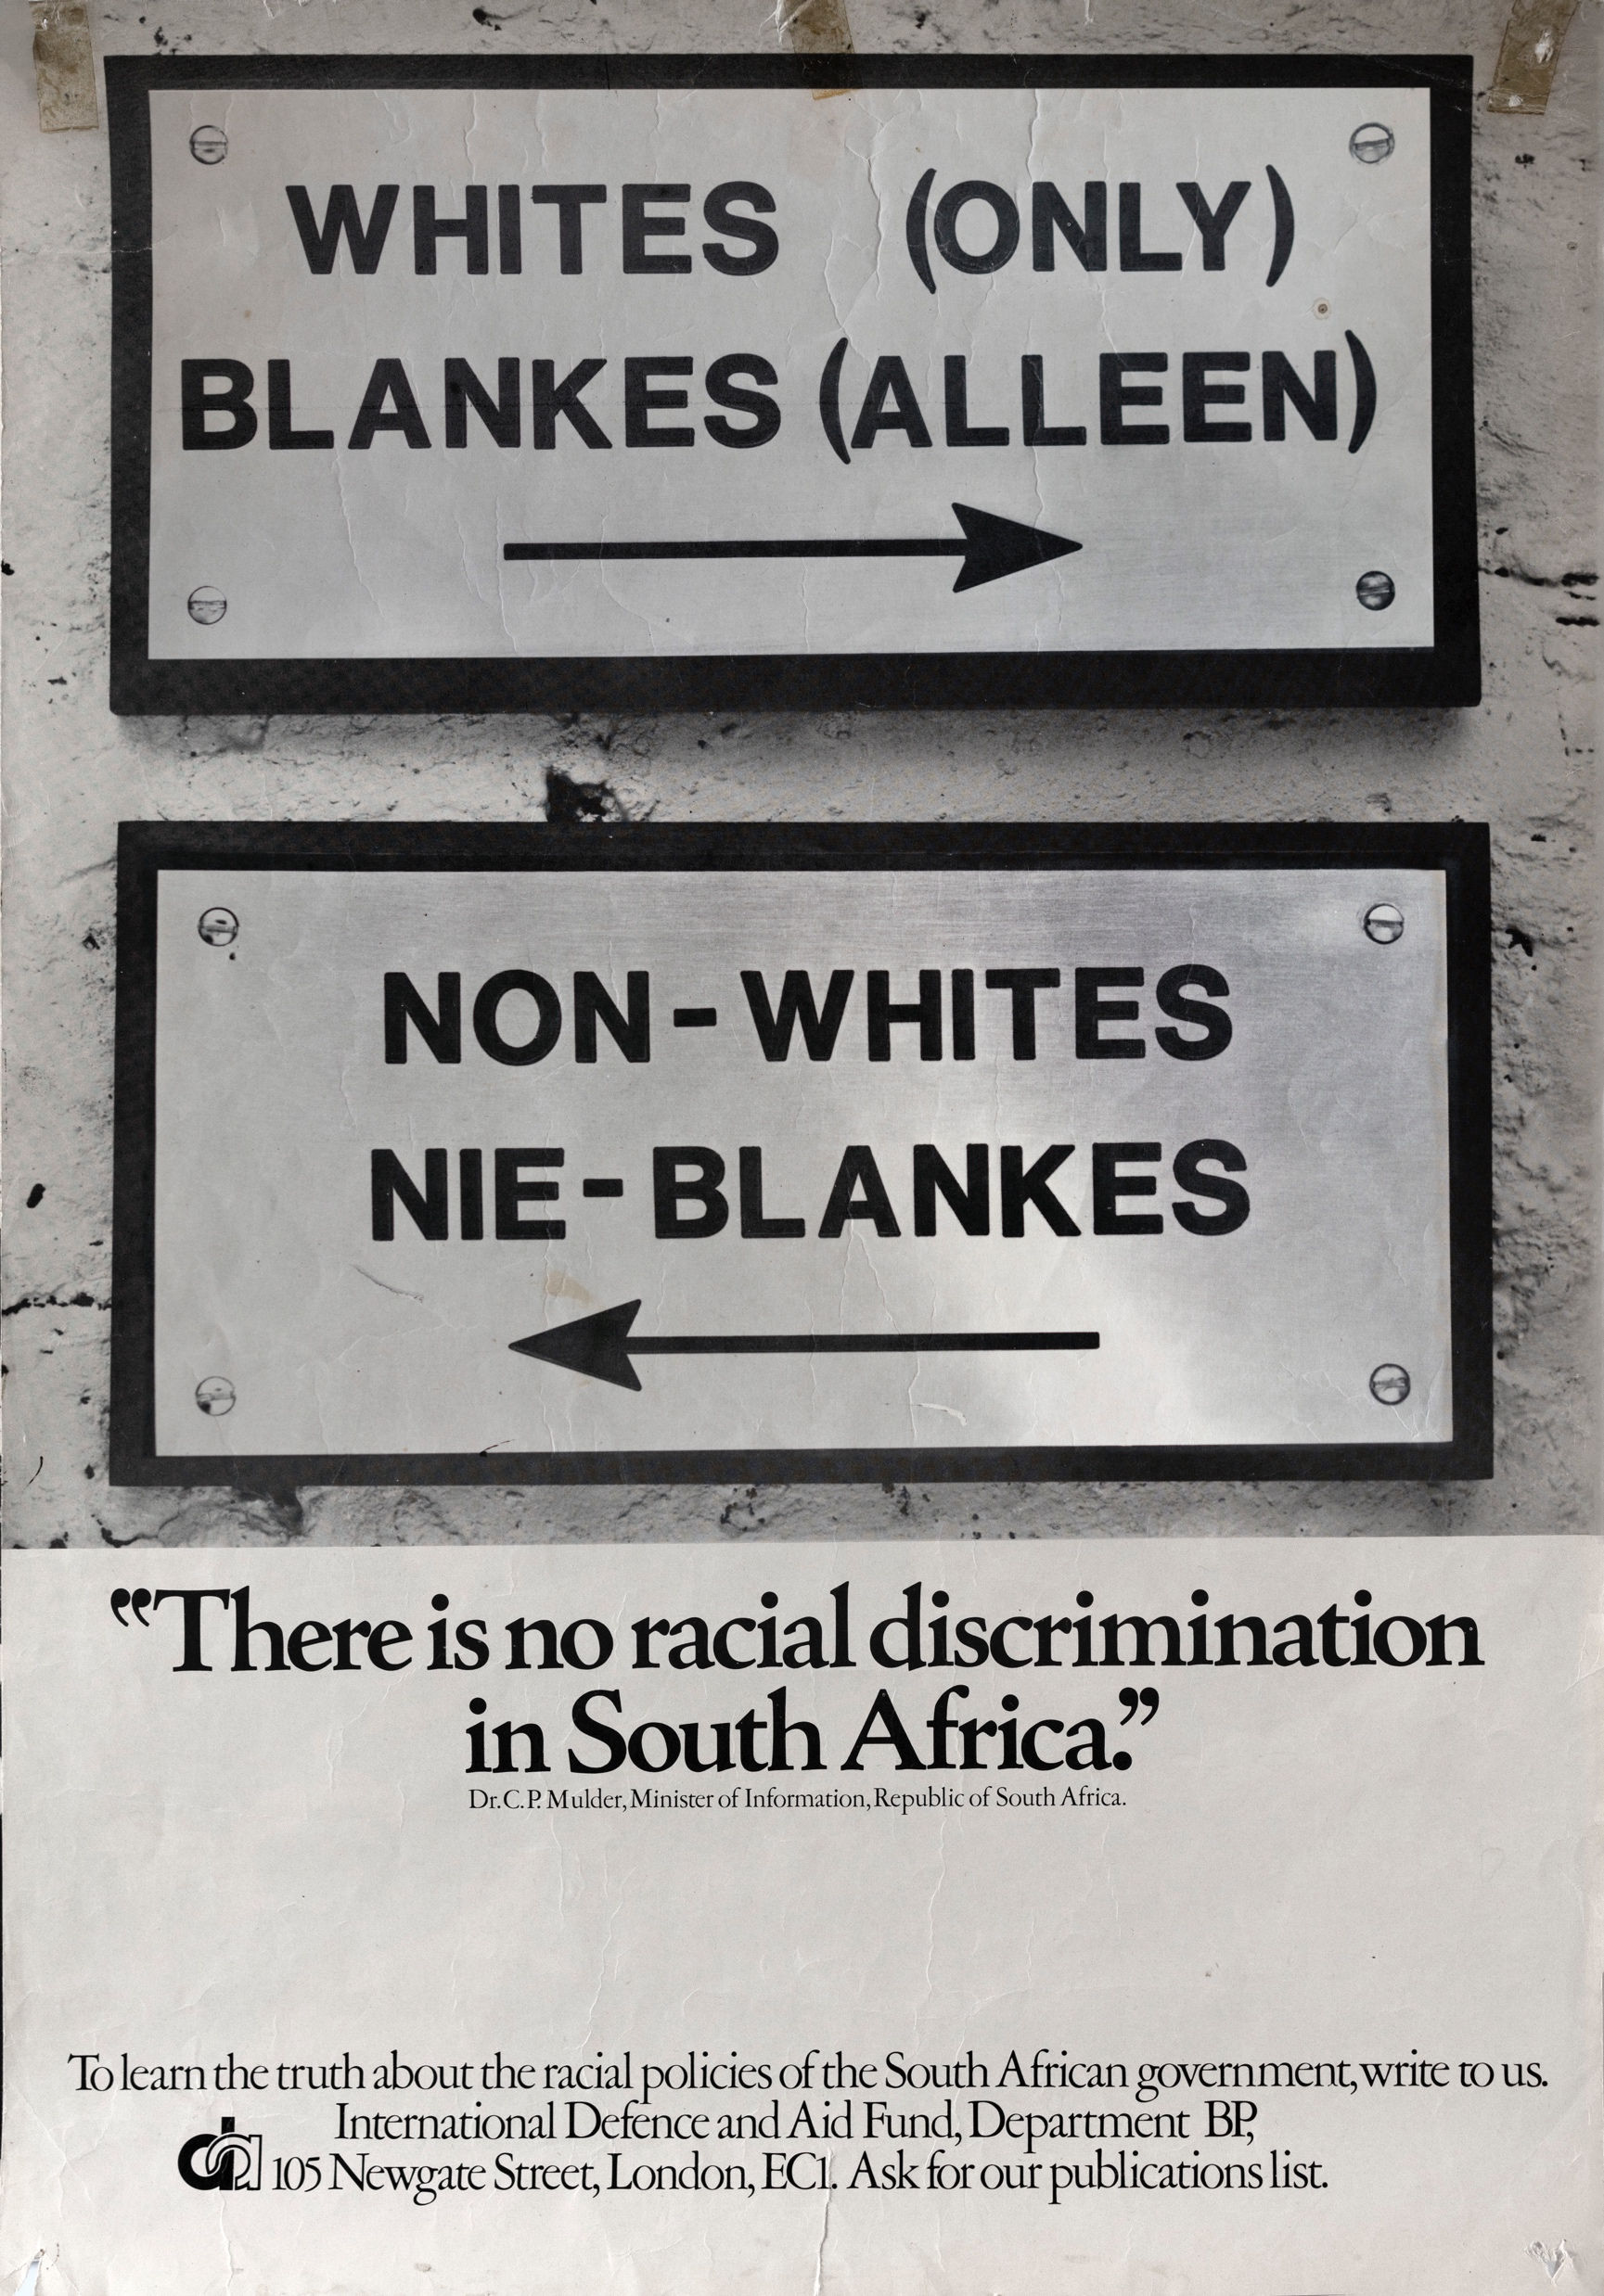
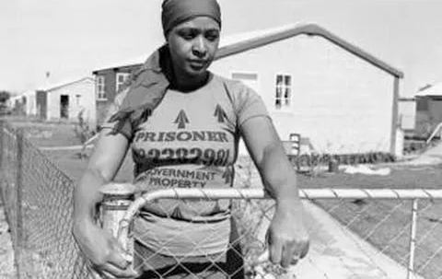
Group Discussion
What have you learned today that you did not know before?
Has this session changed how you think about apartheid or the anti-apartheid movement?
What were the effects and impact of exile? (On individuals, families, groups, South Africa etc.)
Image links:
Poster showing ‘Whites (only)’ and ‘Non-whites’ sign.
Winnie Mandela in 1977, during her exile in Brandfort, S.A

Slide 9
About This Resource
The University of East Anglia is a globally significant centre of research that drives global change. We bring fresh thinking to the major challenges facing society, helping to create a better future for all.
The Anti Apartheid Legacy: Centre of Memory and Learning promotes the legacy and values of the Southern African liberation struggle and the UK’s central role within this world-changing history, whilst supporting contemporary discourse around social (in)justice, inclusion and multi-racial collaboration for social transformation.
This presentation is part of a resource collaboratively developed by The Anti-Apartheid Legacy: Centre of Memory and Learning (CML) and UEA. It is part of the CML’s work to promote the legacy and values of the Southern African liberation struggle, whilst supporting contemporary discourse around social (in)justice, inclusion and multi-racial collaboration for social transformation
Many of the images and linked documents are supplied with kind permission of project partners, The Anti-Apartheid Movement Archives. Other sources are referred to at the relevant places in the packs.
The development of the resources has been made possible with generous support from the National Lottery Heritage Fund and UEA’s Impact Fund.
The Anti Apartheid Movement Archives Forward to Freedom tells the story of the British Anti-Apartheid Movement and its campaigns to support the people of South Africa in their fight against apartheid.
The National Lottery Heritage Fund As the largest dedicated funder of the UK’s heritage, The National Lottery Heritage Fund’s vision is for heritage to be valued, cared for and sustained for everyone, now and in the future.

