Slide 1





Slide 2

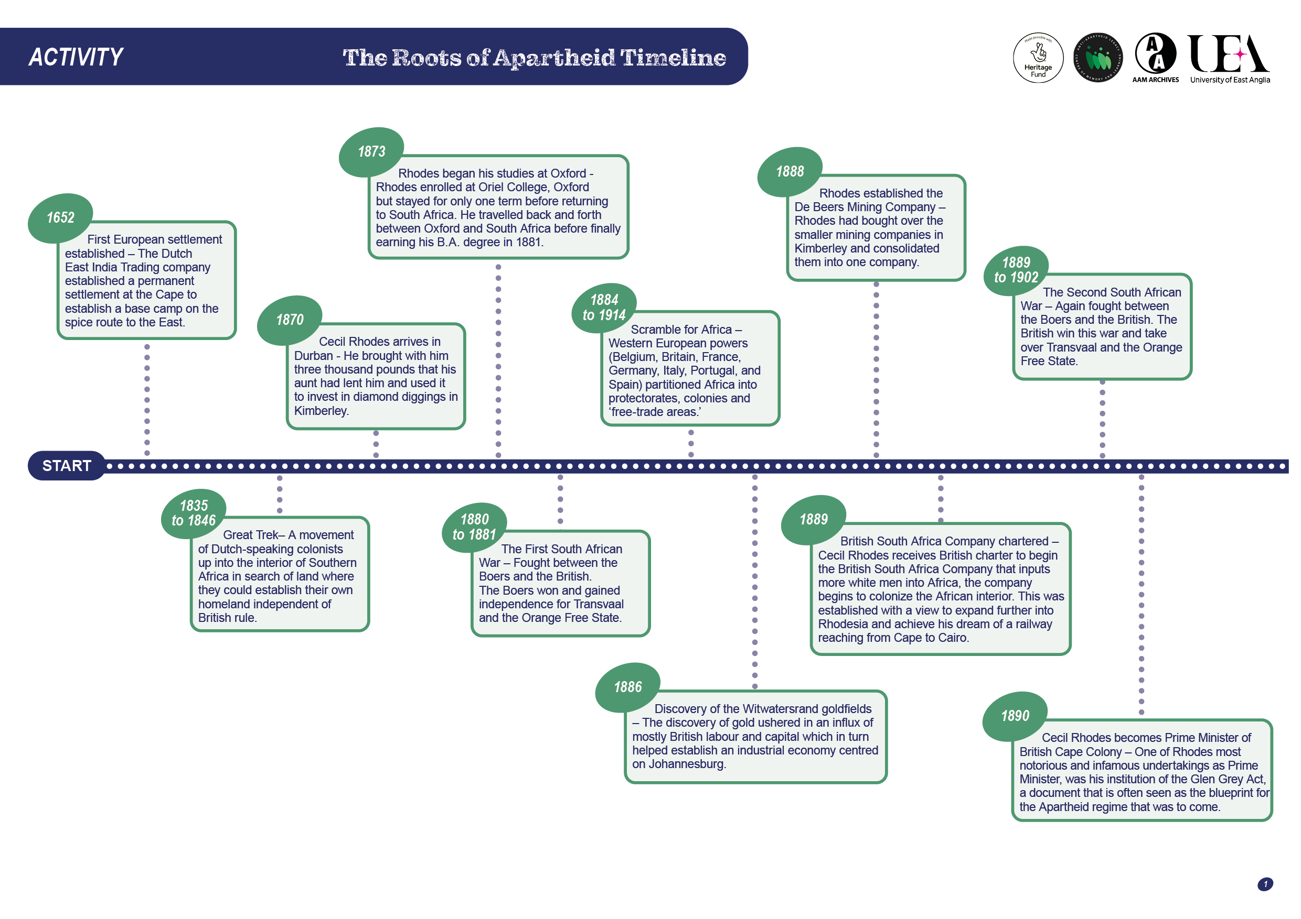
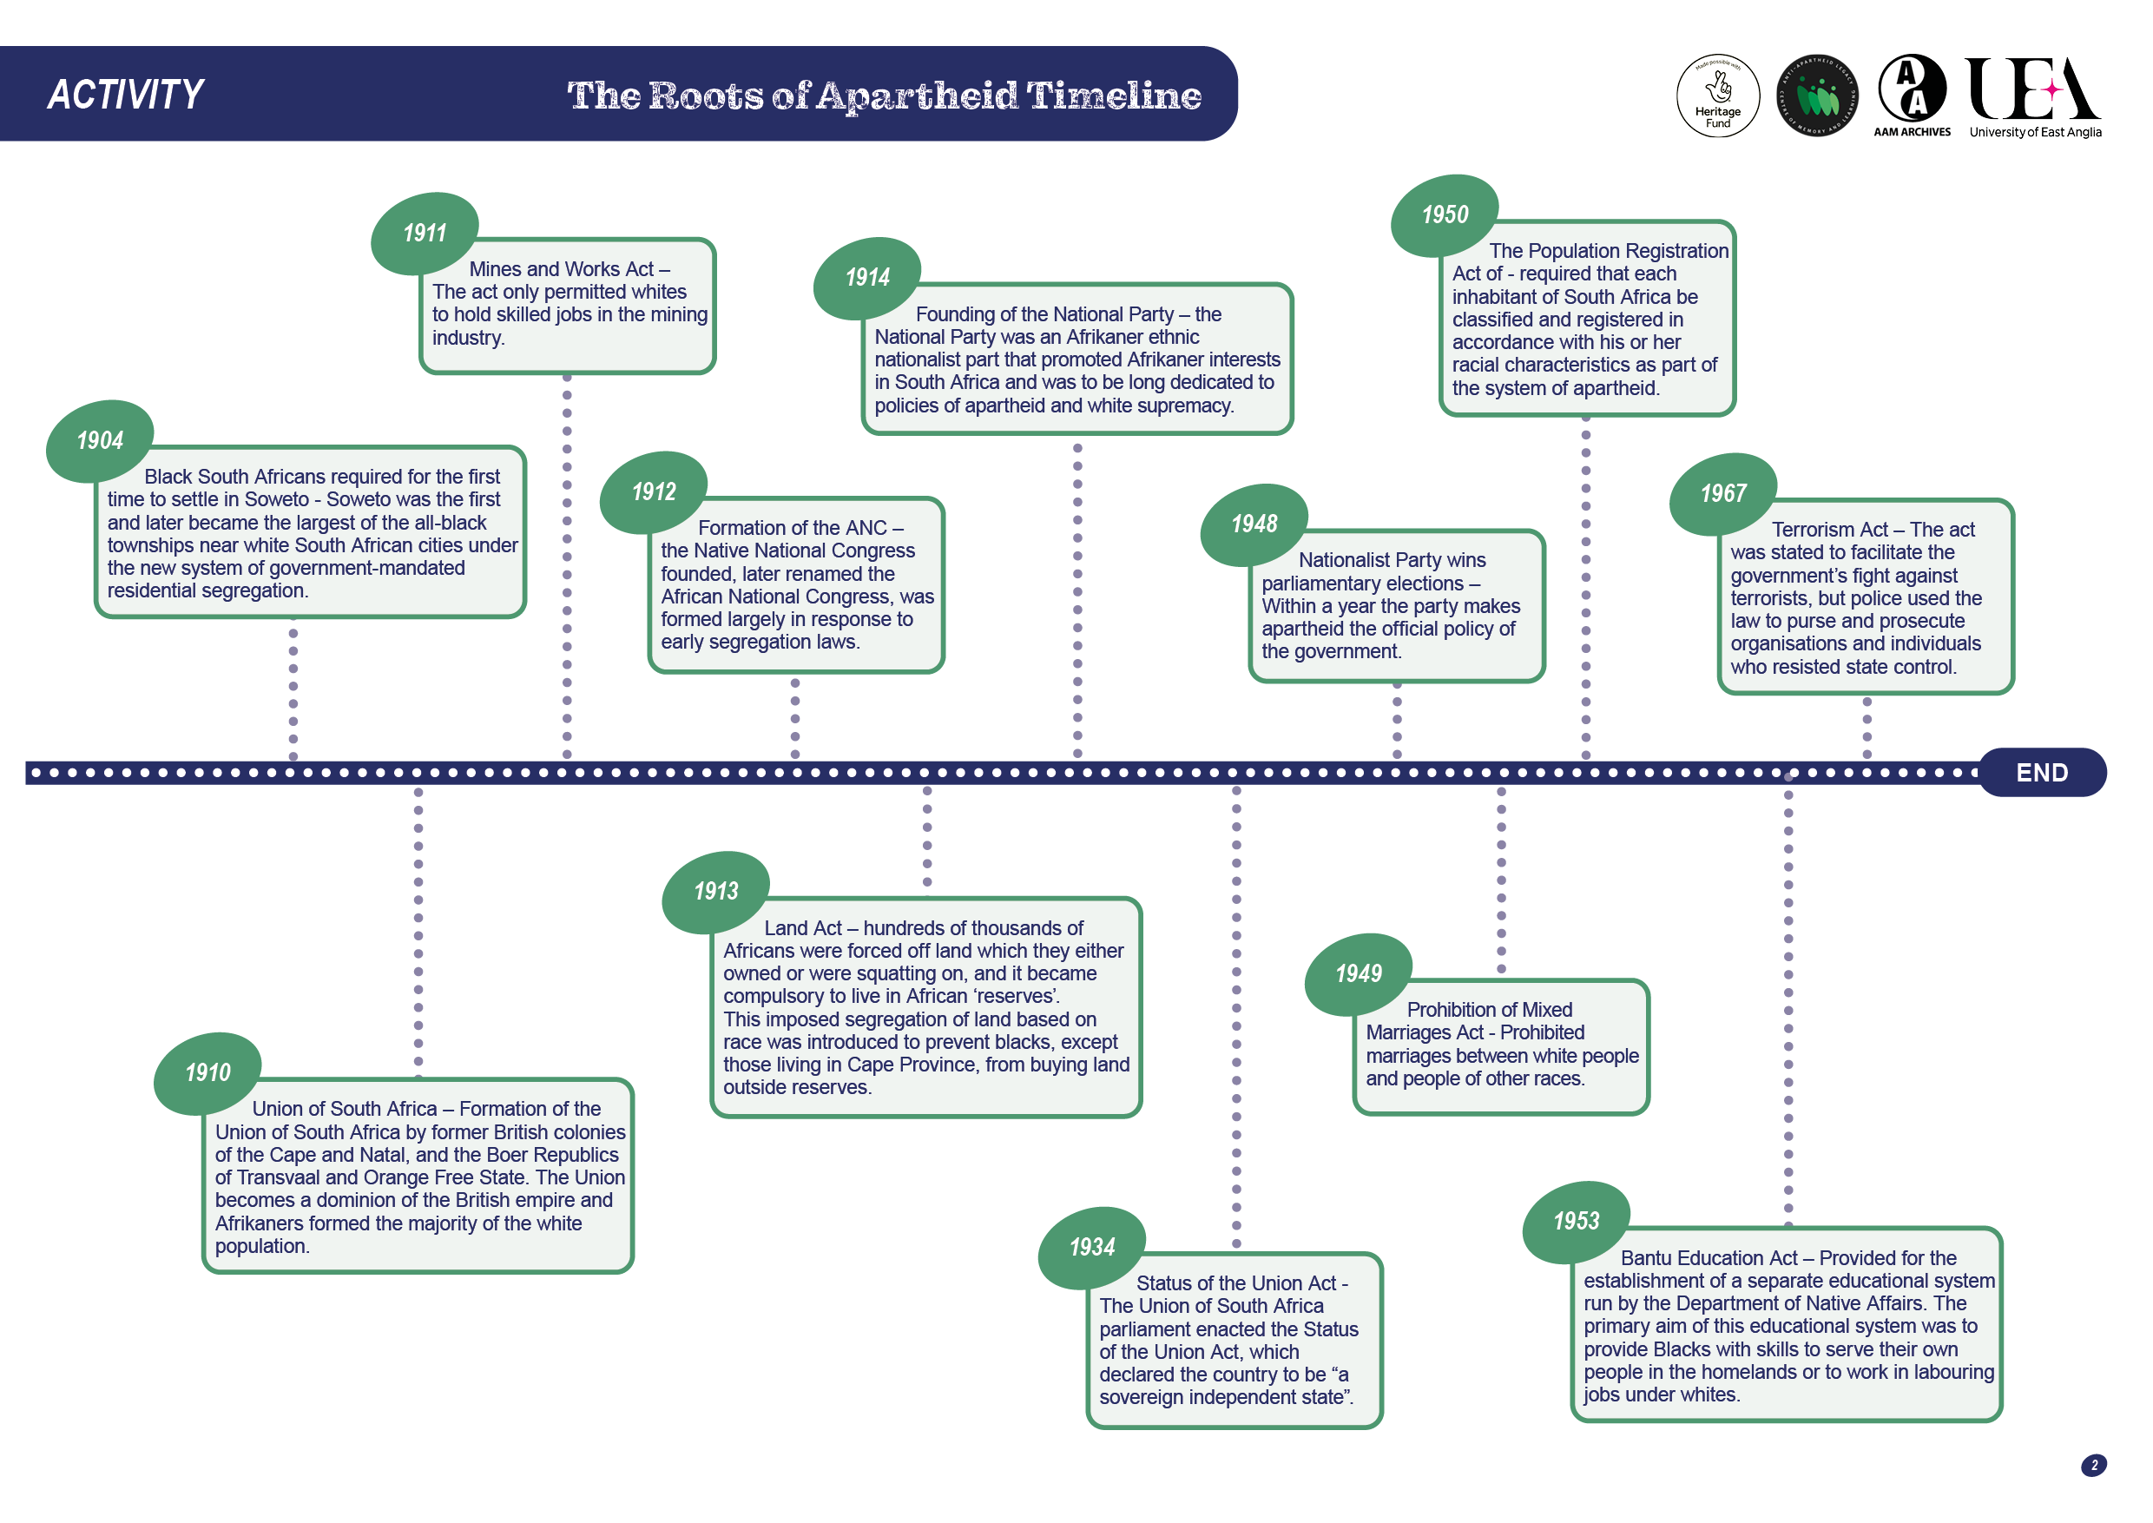
Timeline
Working on your own or in groups, use the resource files and timeline template in this pack to create a timeline of the roots of apartheid.
Try to structure each point:
Event
Outline – what happened?
Significance – why was this important?
Highlight particularly significant events or turning points.

Slide 3
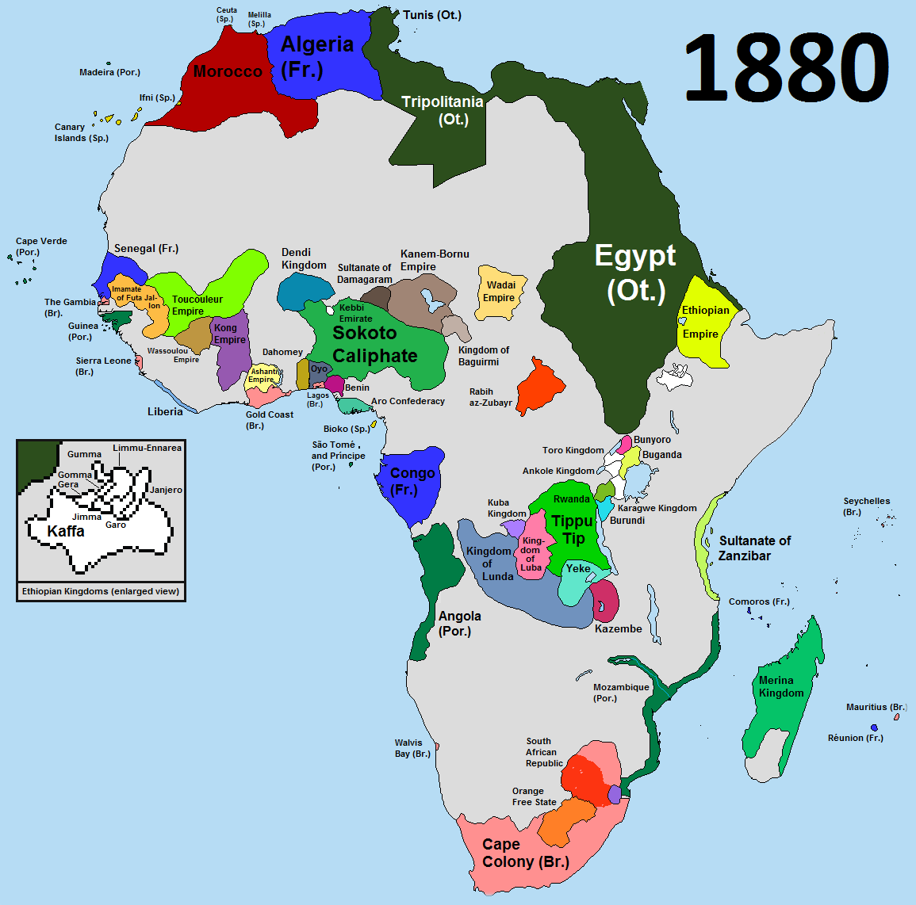
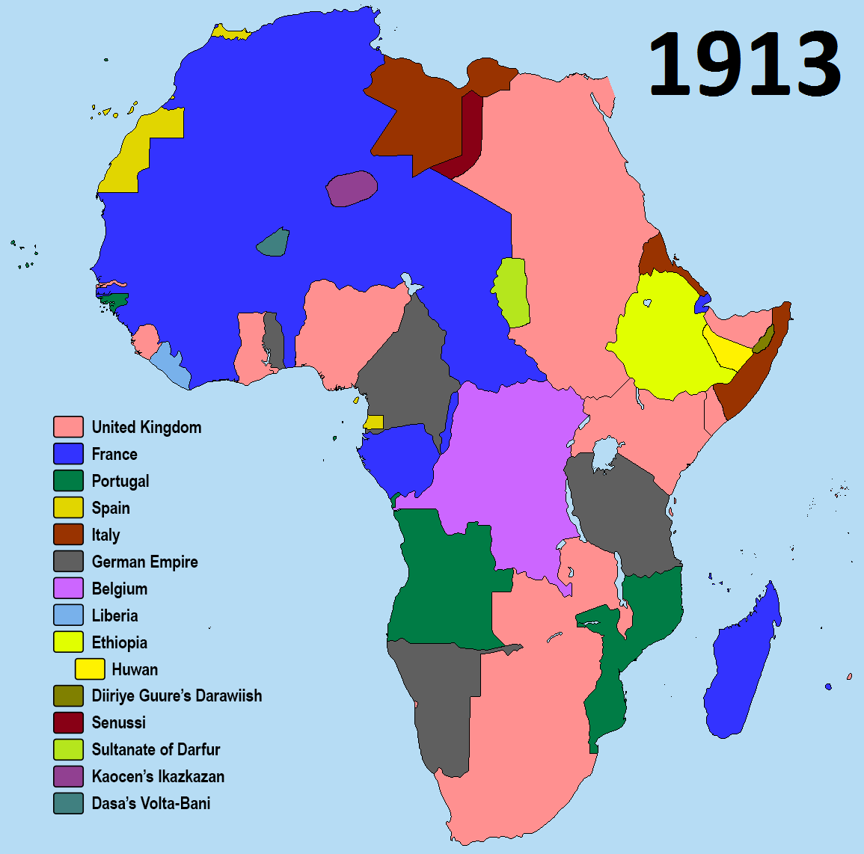
South Africa in Maps
As late as 1880, 90% of the continent of Africa was formally free from European colonial rule.
The Scramble for Africa saw European powers take over the continent and attempt to colonise it.
By 1914 European powers controlled 90% of the continent.
Only Abyssinia (Ethiopia) and Liberia retained independence.
Image link:
Colonial Africa On The Eve of World War I – Brilliant Maps

Slide 4
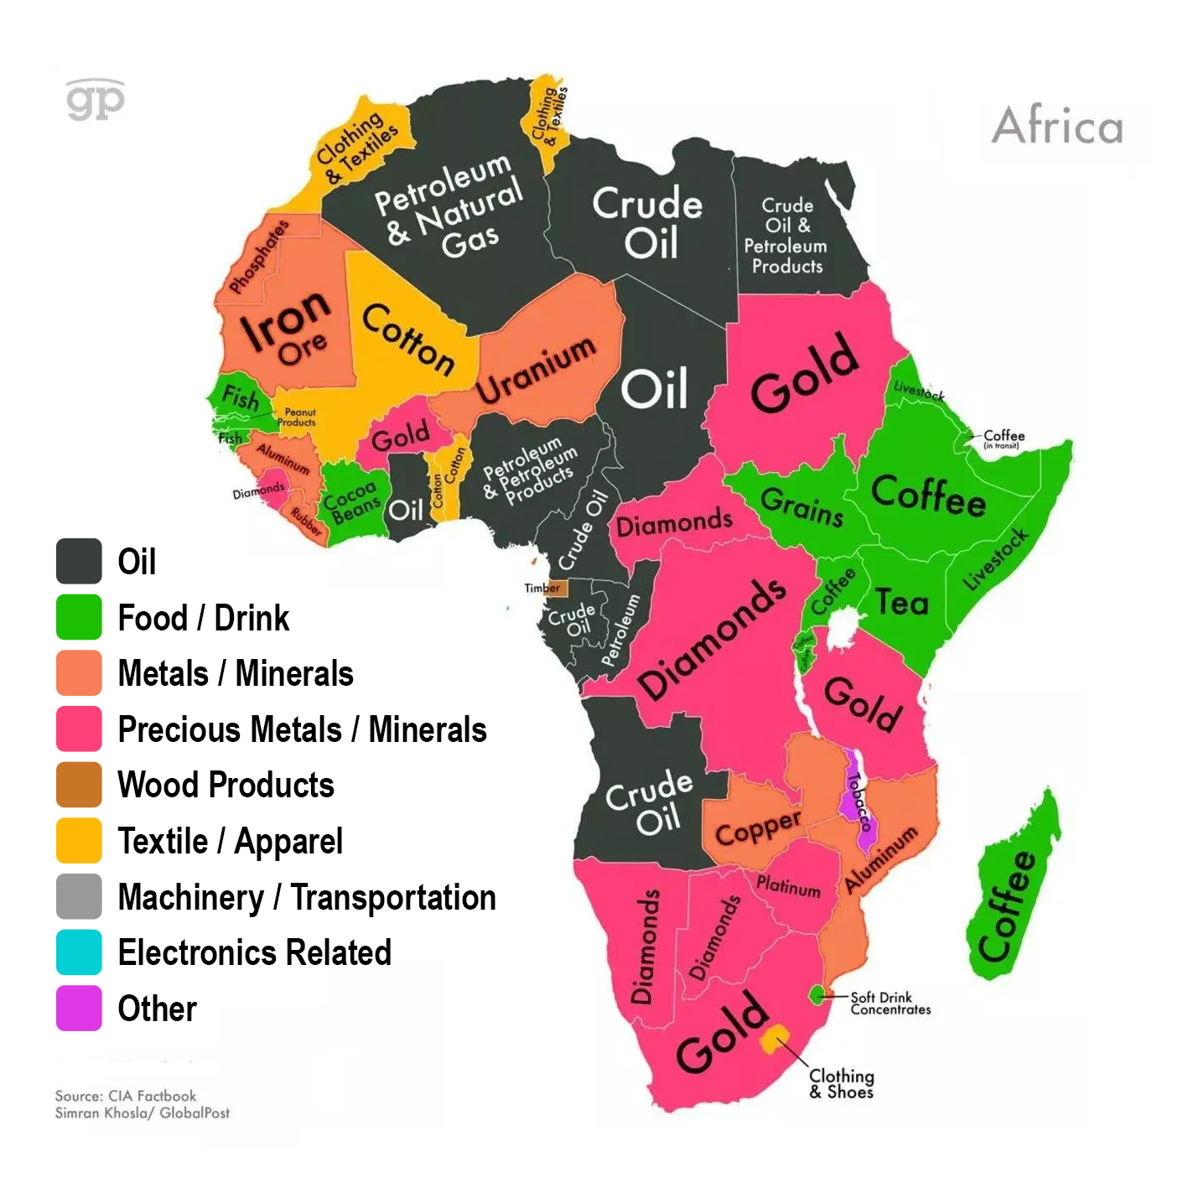

South Africa
in Maps
Africa is rich in oil and other natural resources. The continent also holds a strategic position.
This was one of the reasons why European countries began competing for land.
This map shows some of the resources and where they are located on the continent.
Image link:
Mapping Africa's natural resources (dunyabulteni.net)

Slide 5

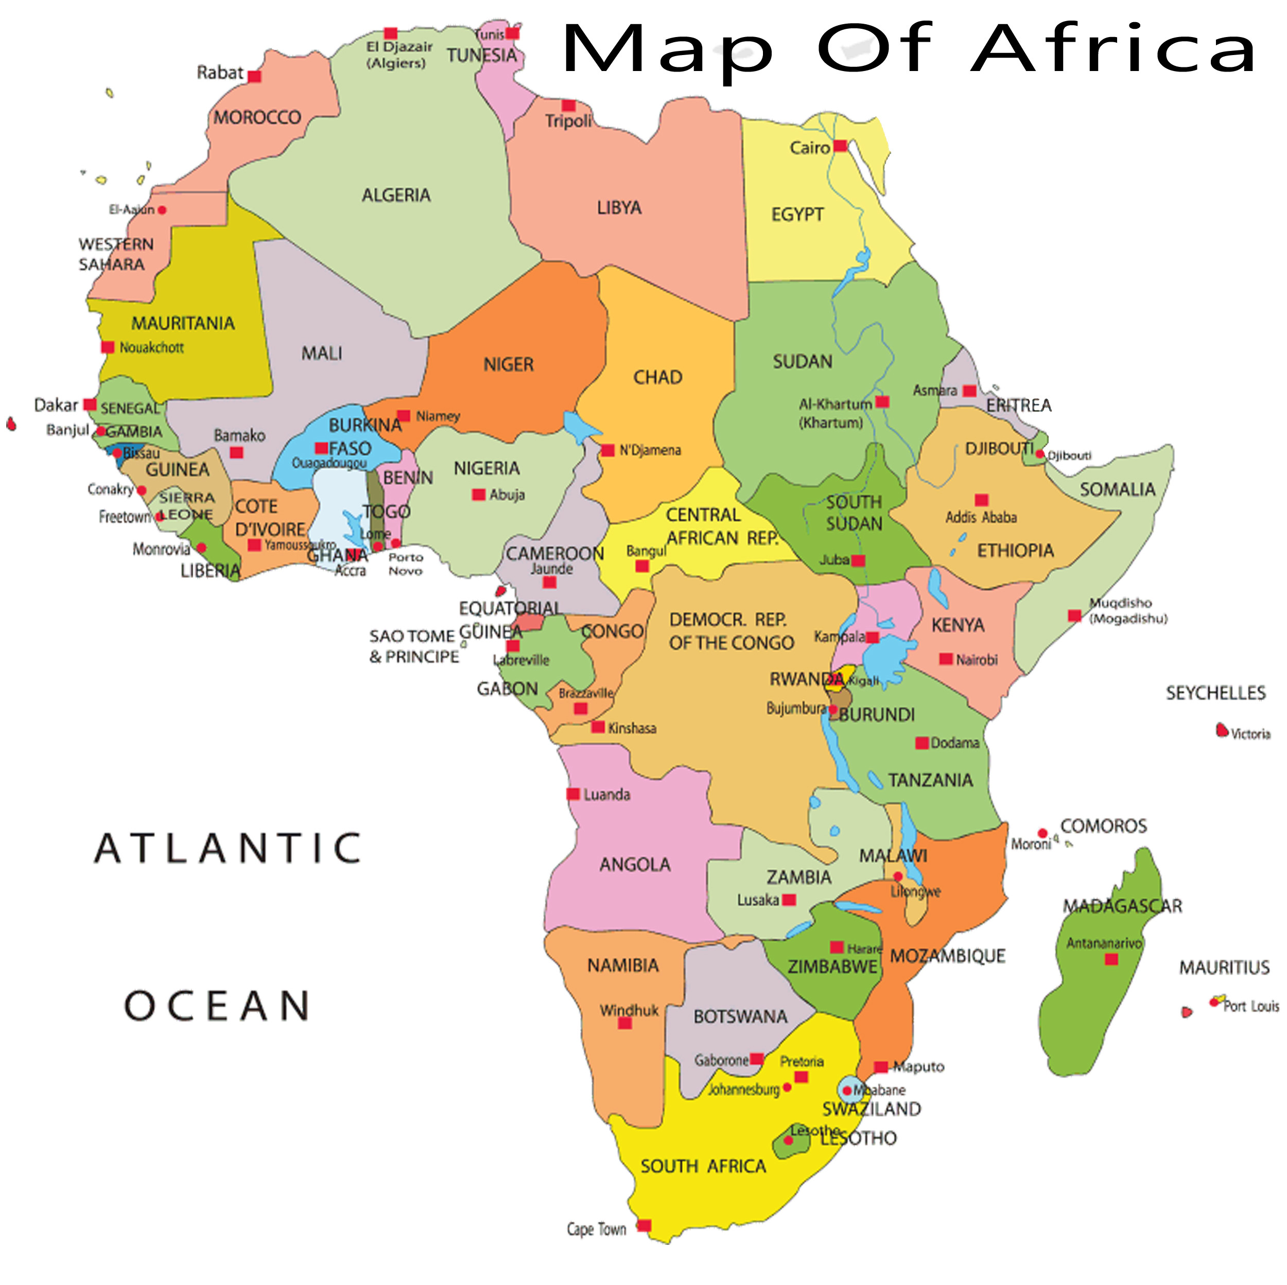
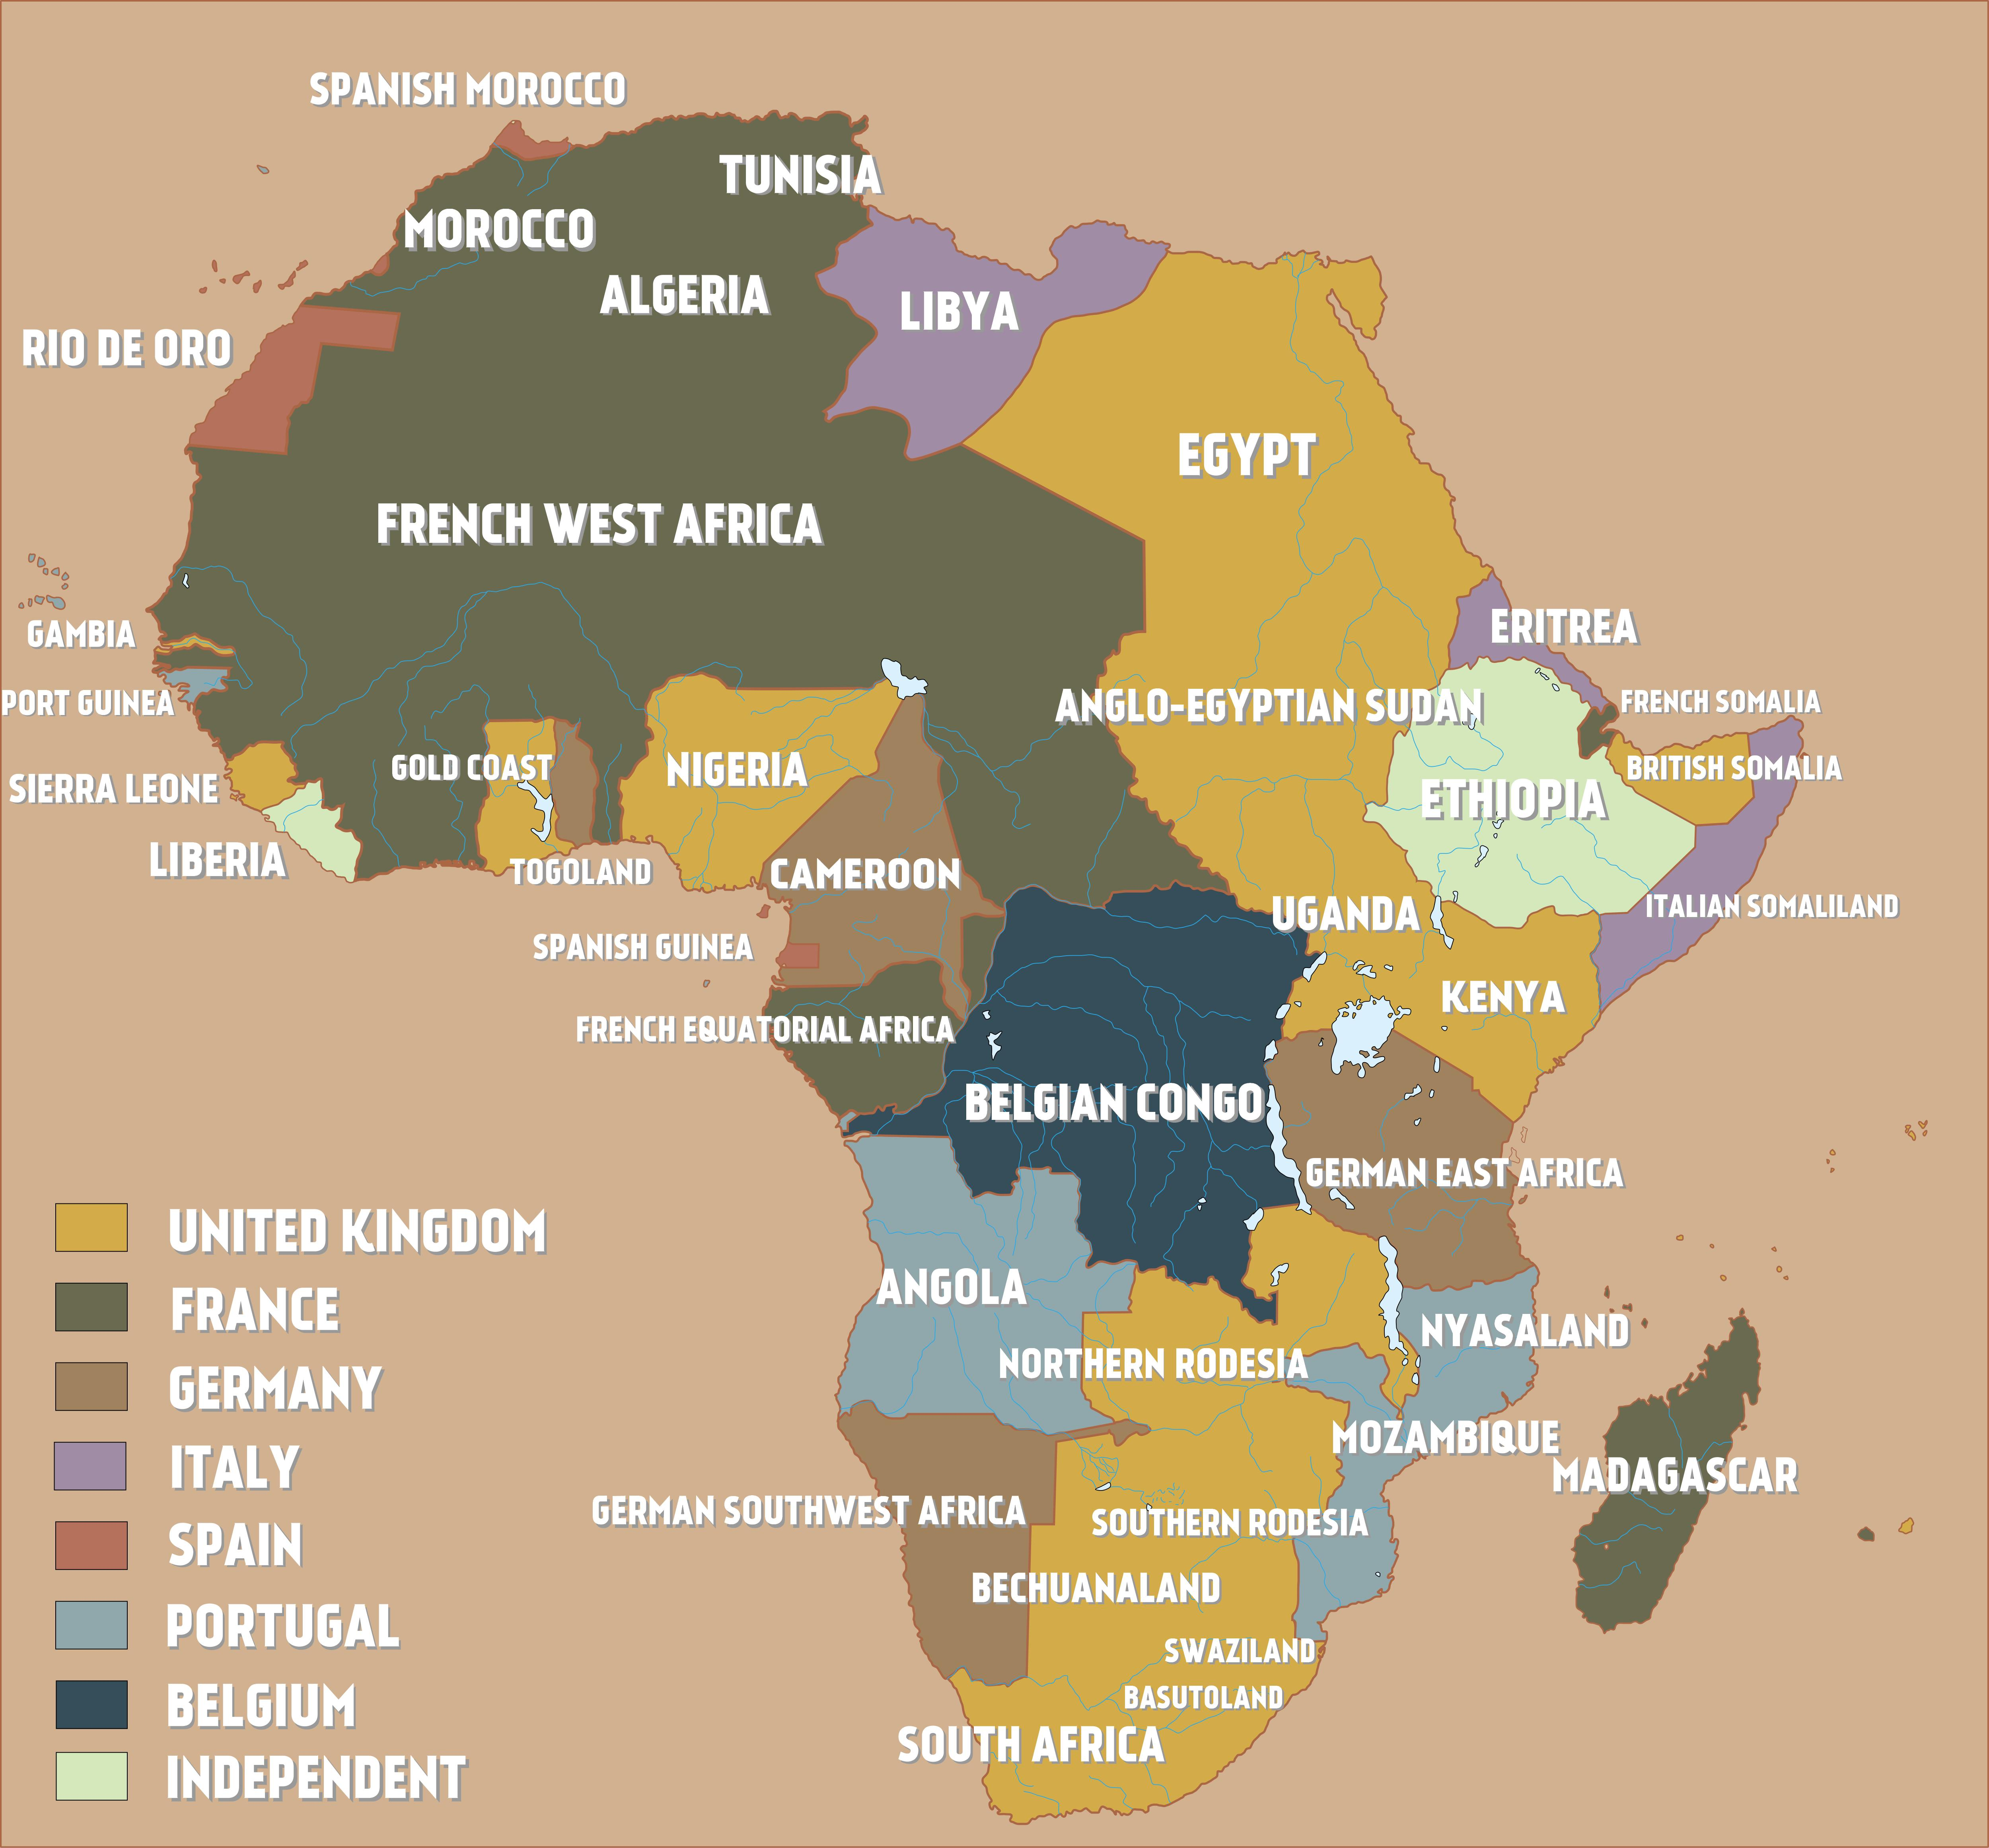
South Africa
in Maps
1914
A lot of the names given to these countries and regions by the European countries who colonised them no longer exist today.
This is why you may not recognise some of them.
Today
Image links:
Colonial Africa On The Eve of World War I – Brilliant Maps
Map of Africa – Chamaeleon Web Services

Slide 6
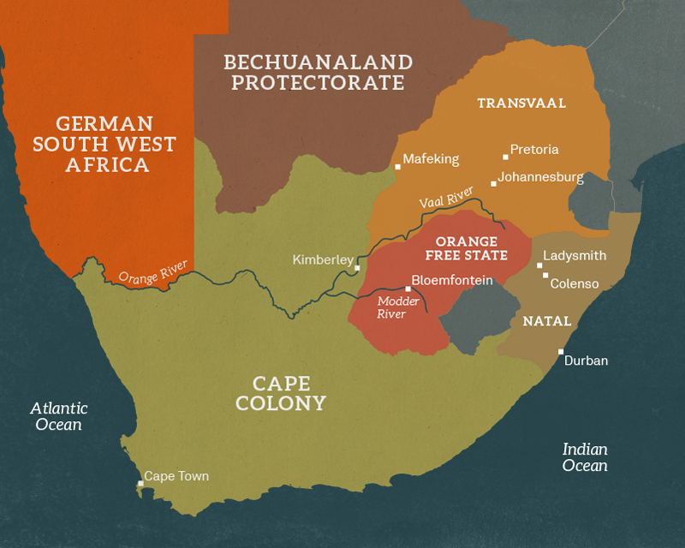
The South African Wars
The Boer Wars was the name given to the South African Wars
of 1880-1 and 1899-1902, that were fought between the British
and the descendants of the Dutch settlers (Boers) in Africa.
Between 1835 and 1845, about 15,000 Voortrekkers
(people of Dutch extract) moved out of the (British) Cape
Colony into the interior of South Africa in the 'Great Trek'.
They established two independent republics - the Transvaal
and the Orange Free State.
The republicans acquired the name 'Boers', the Dutch and
Afrikaans word for farmers.
In 1877 the British Army moved in to control the Orange Free State in pursuit of diamonds, one of the Orange Free State's rich natural resources.
In 1880 the first South African War began, the British were defeated.
The Second South African War was fought from 1899 to 1902 the two independent republics lost and were absorbed into the British Empire.
Image link:
Boer War | National Army Museum (nam.ac.uk)

Slide 7
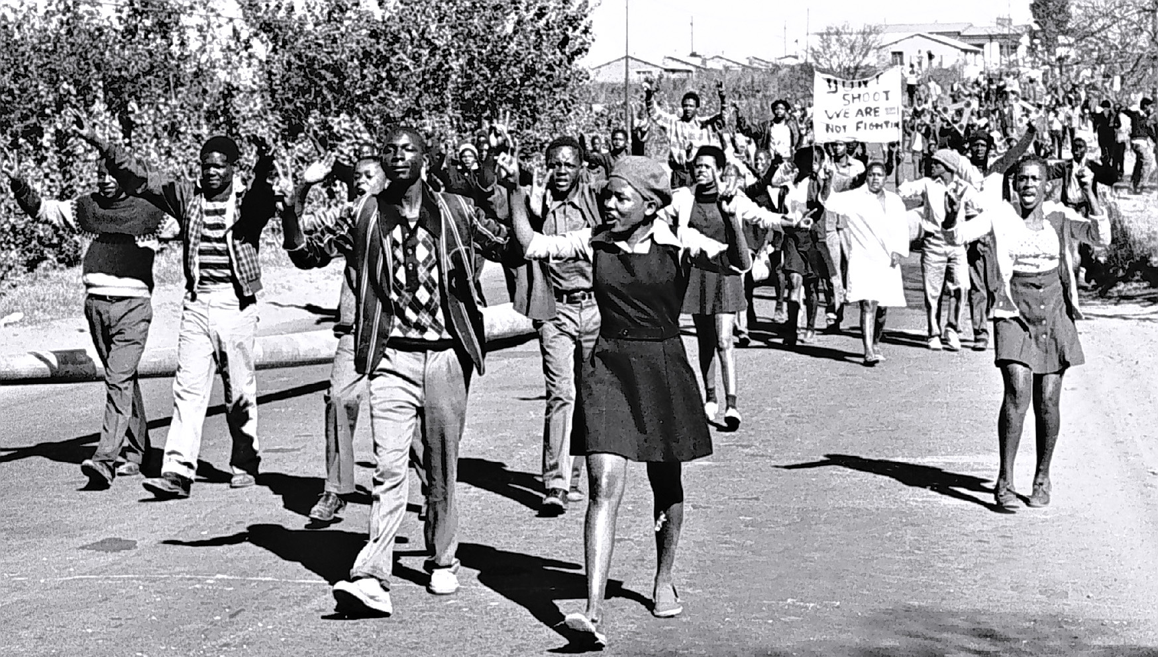
Soweto Uprising
The 1953 Bantu Education Act Provided for the establishment of a separate educational system run by the Department of Native Affairs.
In June 16, 1976, thousands of black high school students took to the streets of Soweto to protest a racially discriminatory educational policy that forced them to use Afrikaans as the official language in the classroom.
Many of them carried signs that read, 'Down with Afrikaans' and 'Bantu Education – to Hell with it;' others sang freedom songs as the unarmed crowd of schoolchildren marched towards Orlando soccer stadium where a peaceful rally had been planned.
Image link:
The June 16 Soweto Youth Uprising | South African History Online (sahistory.org.za)

Slide 8
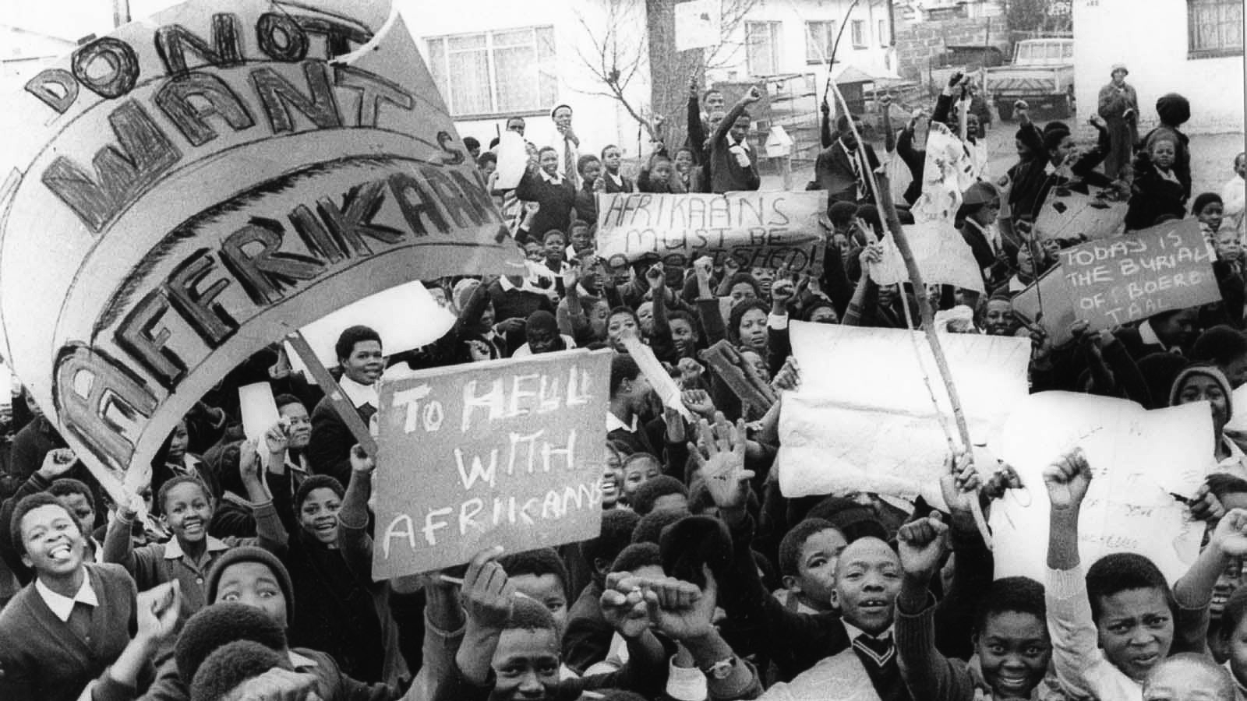
Soweto Uprising
Unpack this event further…
How important was education to colonisation and the system of apartheid?
How far do you think these attitudes are still present today?
Image link:
The June 16 Soweto Youth Uprising | South African History Online (sahistory.org.za)

Slide 9
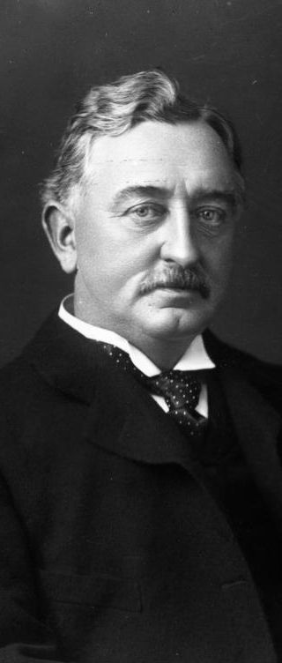
Cecil Rhodes
Born in 1853 at Bishop’s Stortford in Hertfordshire, Rhodes went to South Africa age 17 to improve his health.
In 1876, he briefly returned to England to attend university at Oxford’s Oriel College. However, he only stayed for one term.
Rhodes was chairman of De Beers and
Gold Fields mining companies and managing director of the British South Africa Company that was extending the territory of the British Empire into what became Rhodesia and Zambia (now modern day Zimbabwe and Zambia).
Rhodes dreamt of building a trade route from Cairo to Cape Town which would never leave British territory
Rhodes served as prime minister of the
Cape Colony from 1890 to 1896, when he expropriated land from black Africans and tripled the wealth requirement for voting, effectively barring many black people from taking part in elections.
Rhodes believed the British to be a superior race, stating, “I contend that we are the first race in the world, and that the more of the world we inhabit the better it is for the human race.”
In his will, he asked to establish the prestigious Rhodes Scholarship at Oxford University. He was honoured with a statue
at Oriel College, and one of the buildings was also named after him.
Image link:
Image link:
cecil-rhodes.jpg (564×752) (independent.co.uk)

Slide 10
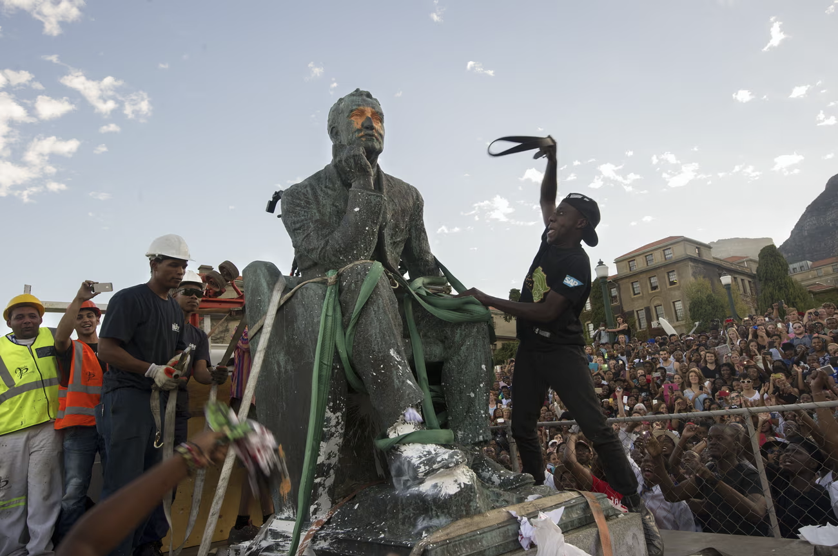
Rhodes Must Fall
Began with a protest action at the University of Cape Town on 9 March 2015.
Originally directed against a statue at the University of Cape Town (UCT) that commemorates Cecil Rhodes.
The campaign for the statue's removal received global attention and led to a wider movement to decolonise education across South Africa.
In April 2015, following a UCT Council vote, the statue was removed.
Image link:
The birth of Rhodes Must Fall | South Africa | The Guardian

Slide 11

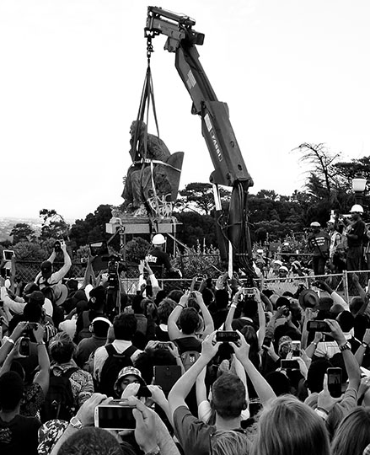
Why was Rhodes so controversial?
Rhodes believed the British to be a “master race”. He is seen by some as the ultimate representation of colonialism.
Rhodes and his British South Africa Company founded the southern African territory of Rhodesia in the 1890s.
Rhodes annexed huge amounts of land in southern Africa, and helped pave the way for apartheid.
Rhodes served as prime minister of the Cape Colony from 1890 to 1896, when he seized land from black Africans and tripled the wealth requirement for voting, which effectively barred many black people from participating in elections.
Image link:
'Rhodes Must Fall' and Decolonizing Education | AAIHS

Slide 12
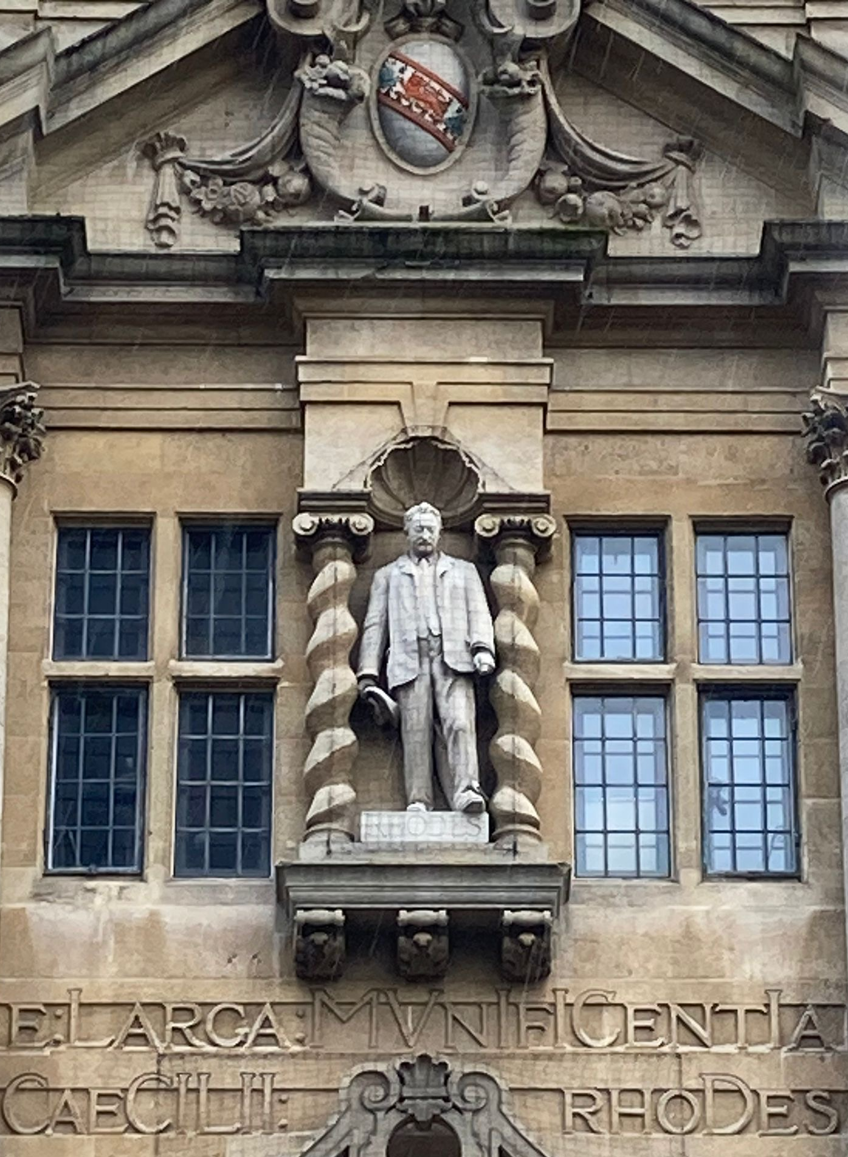
Rhodes Must Fall
“Time to take figures like Rhodes down off their pedestals.”
“I hope they can find a good home for him where we can discuss him rather than (appear to) venerate him.”
VS
“Rhodes's generosity allowed thousands of young people to enjoy an education they could not otherwise have had.”
“My own view on this is that hiding our history is not the route to enlightenment.”
Have you seen the stories about this statue in the news?
What do you think about whether his statue should be taken down?
Read more...

Slide 13
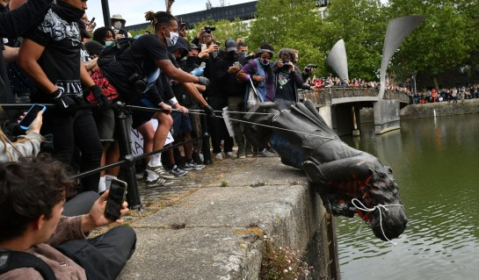
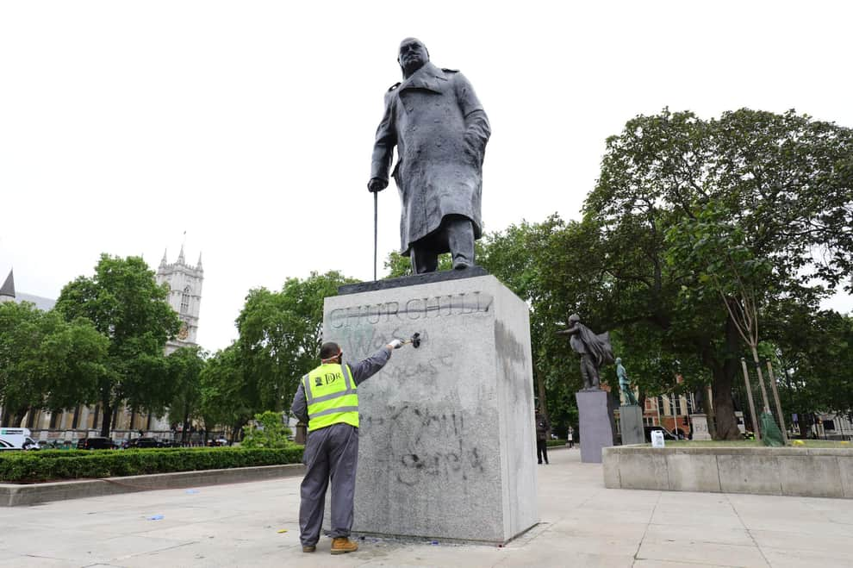
Group Discussion
What are the political uses of the past?
How do we investigate history when there are political and cultural agendas?
Are there different ways of teaching history?
Can history ever be objective?
Edward Colston, Bristol, June 2020
Image links:
Edward Colston statue: Government minister calls for prosecutions after Bristol memorial pulled down during protests (inews.co.uk)
Why was a Winston Churchill statue defaced? The life and views of the UK wartime PM as graffiti brands him 'racist' | Edinburgh News (scotsman.com)
Winston Churchill, Westminster, June 2020

Slide 14




About This Resource
The University of East Anglia is a globally significant centre of research that drives global change. We bring fresh thinking to the major challenges facing society, helping to create a better future for all.
The Anti Apartheid Legacy: Centre of Memory and Learning promotes the legacy and values of the Southern African liberation struggle and the UK’s central role within this world-changing history, whilst supporting contemporary discourse around social (in)justice, inclusion and multi-racial collaboration for social transformation.
This presentation is part of a resource collaboratively developed by The Anti-Apartheid Legacy: Centre of Memory and Learning (CML) and UEA. It is part of the CML’s work to promote the legacy and values of the Southern African liberation struggle, whilst supporting contemporary discourse around social (in)justice, inclusion and multi-racial collaboration for social transformation
Many of the images and linked documents are supplied with kind permission of project partners, The Anti-Apartheid Movement Archives. Other sources are referred to at the relevant places in the packs.
The development of the resources has been made possible with generous support from the National Lottery Heritage Fund and UEA’s Impact Fund.
The Anti Apartheid Movement Archives Forward to Freedom tells the story of the British Anti-Apartheid Movement and its campaigns to support the people of South Africa in their fight against apartheid.
The National Lottery Heritage Fund
As the largest dedicated funder of the UK’s heritage, The National Lottery Heritage Fund’s vision is for heritage to be valued, cared for and sustained for everyone, now and in the future.

