Slide 1




A Note for Teachers
This presentation is part of a multi-lesson resource on Exploring the Freedom Charter, which was collaboratively developed by Teach for Tomorrow, the Anti-Apartheid Legacy Centre and the University of East Anglia. These educational resources aim to teach students about the Freedom Charter and the context of Apartheid South Africa during its creation, in order to promote the legacy and values of the Southern African liberation struggle, whilst supporting contemporary discourse around social (in)justice, inclusion and multi-racial collaboration for social transformation.
While you may need to modify this presentation to meet the needs of your students, please note that Teach for Tomorrow, the Anti-Apartheid Legacy Trust and the University of East Anglia do not endorse changes that alter the presentation's content or layout.

Slide 2
Lesson One
Confronting Apartheid
Exploring the Freedom Charter

Slide 3
Guiding Questions
How did living under apartheid affect the lives of South Africans?
What are the impacts of excluding people on account of one of their identities?

Slide 4
Learning Objective
To understand what apartheid was and how it affected the lives of South Africans.

Slide 5

Reflect on Exclusion
Reflect on the following prompts in a journal response:
Think about a time when you were excluded and/or treated differently on account of a feature of one of your identities (or perceived identities).
What was going on in the situation?
How did it feel to be excluded and/or treated differently?
What, if anything, were the consequences?
What did this experience teach you?
Notes:
Inform students that they will be learning about Apartheid in South Africa. Before doing so, ask them to reflect on the questions in a journal response. Inform them that they will not be required to share their answers.
You may wish to invite any students who feel comfortable doing so share any reflections they had on completing the journal response, particularly any thoughts on the final question. Given the personal nature of these questions, this should not be a requirement and you may wish to model by going first.

Slide 6

Reflect on the Term ‘Apartheid’
What is your understanding of the meaning of the word ‘apartheid’?
Notes:
Next, invite students to share their understanding of what the word ‘apartheid’ means. Students may have heard the term, but may struggle to articulate a definition.

Slide 7
‘Apartheid’ Definitions
Separation and discrimination on account of identity.
A policy in South Africa that separated people from others and discriminated against the non-white majority on account of their race.
In Afrikaans, apartheid means ‘separateness’ (apart = separate + heid = hood).
Afrikaans is a language rooted in Dutch spoken by Afrikaners (white South Africans, who were originally descended from Dutch colonists).
Notes:
Then share the definitions.

Slide 8

Learn About Apartheid
Afrikaners: Afrikaners is the name given to white South Africans, most of whom descended from Dutch colonists. Although some were of French and German origin too.
Afrikaans: A language rooted in Dutch spoken by Afrikaners.
Segregation: Keeping one group of people apart from, and treating them different to, another group.
As a class, we will read the handout ‘Early Apartheid and its Context’.
Notes:
Next, distribute the Handout: Early Apartheid and its Context and read it as a class using one of the Read Aloud strategies. You may also choose to share the definitions to facilitate student comprehension as they read.

Slide 9
Discuss ‘Early Apartheid and its Context’
What was apartheid?
How did the listed apartheid laws impact those they targeted?
How did colonialism play a role in the formation of apartheid?
What do you find surprising and/or troubling about the information in this article?
What, if any, parallels do you see between how people were treated during apartheid and how groups of people are treated today?
What does it mean when people are excluded or treated unfairly in society because of their identity (including protected characteristics like race)?
  How does it feel?
  What are the consequences?
Notes:
Once students have read the text, ask students to discuss the following questions in pairs or groups before leading a short class discussion to check for understanding and see if there are any questions.

Slide 10

Explore Life Under Apartheid
As you move around the room, respond to the following questions for each page:
What is the focus of the content?
What does it reveal about life under apartheid?
What does the content make you think/feel?
What, if any, questions does it raise?
Notes:
Inform students they will now be participating in a Gallery Walk to look at content that reveals what life was like under apartheid for the non-white population. Explain to students that the examples on the slides have been selected to shed light on different ways in which the freedoms and mobility of Non-White South Africans were curtailed and policed. Ask them to respond to the questions.
Once students have returned to their seats, lead a short class discussion inviting them to share their reflections and responses to the questions.
You may also choose to collect the questions the Gallery Walk raised on post-it notes in order to review them before the next lesson.

Slide 11
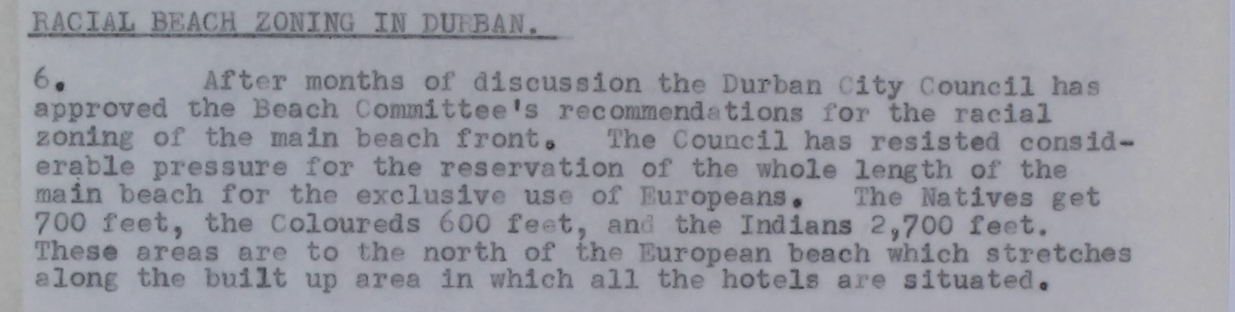
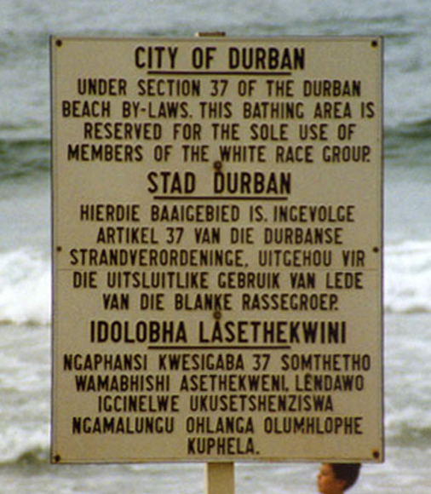
Beach Segregation
RACIAL BEACH ZONING IN DURBAN.
6. After months of discussion the Durban City Council has approved the Beach Committee’s recommendations for the racial zoning of the main beach front. The Council has resisted considerable pressure for the reservation of the whole length of the main beach for the exclusive use of Europeans. The Natives get 700 feet, the Coloured 600 feet, and the Indians 2,700 feet. These areas are to the north of the European beach which stretches along the built-up area in which all the hotels are situated.
Extract from High Commissioner’s report concerning racial beach zoning in Durban, South Africa, October 1955, Catalogue Ref: DO 35/6716
The National Archives
Guinnog
Segregational beach sign in Durban in English, Afrikaans and Zulu. Photo taken in 1989.

Slide 12
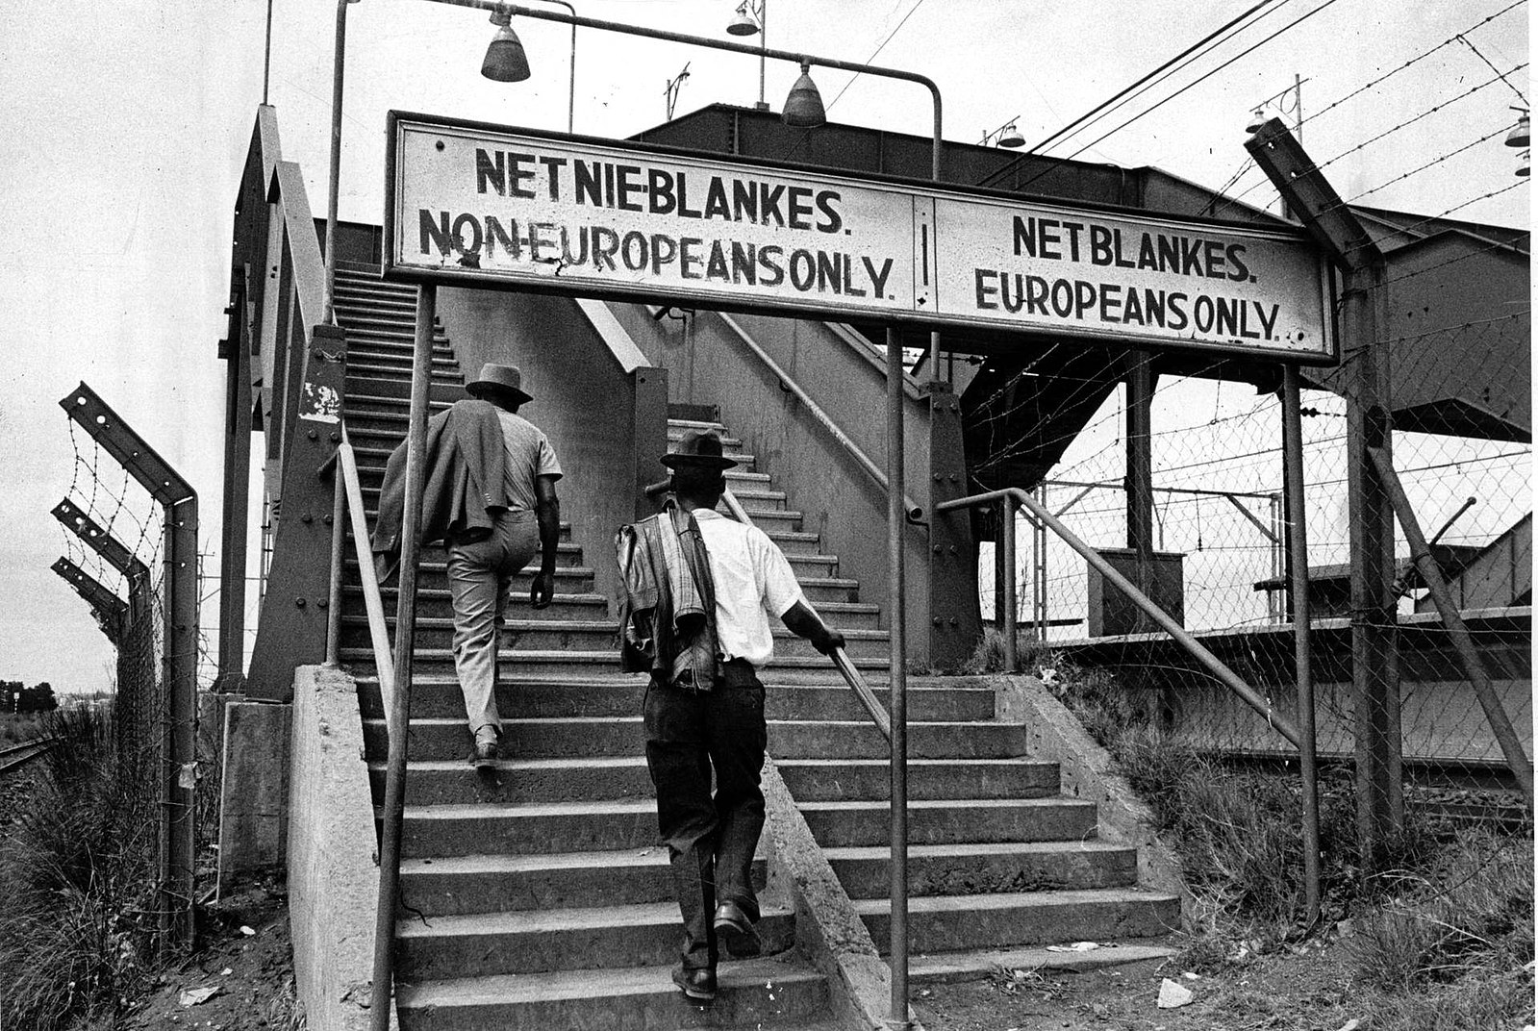
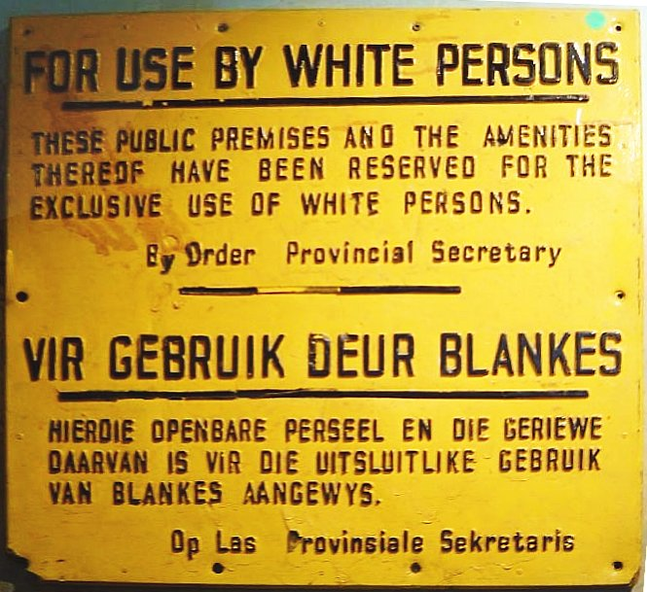
Segregation of Public Amenities
The passing of the Separate Amenities Act 1953 led to the segregation of all public amenities, including buildings and transport. Whites (Europeans) had access to superior facilities than non-whites, who were often described as ‘Coloureds, Indians and Blacks’.
Ernest Cole
Wikicommons
Photograph of segregational signs at a South-African train station taken pre-1972.
Apartheid era sign in English and Afrikaans.

Slide 13
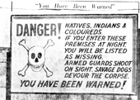
Threats to Life
Reproduction of a road sign that appeared on the barbed wire fence of a farm in Johannesburg. Thousands of similar signs existed throughout South Africa during apartheid. This reproduction is from July 1952.
The text reads:
“You Have Been Warned”
DANGER!
NATIVES, INDIANS AND COLOUREDS.
IF YOU ENTER THESE PREMISES AT NIGHT, YOU WILL BE LISTED AS MISSING.
ARMED GUARDS SHOOT ON SIGHT. SAVAGE DOGS DEVOUR THE CORPSE.
YOU HAVE BEEN WARNED!
Photo Division, Ministry of Information & Broadcasting, Government of India

Slide 14
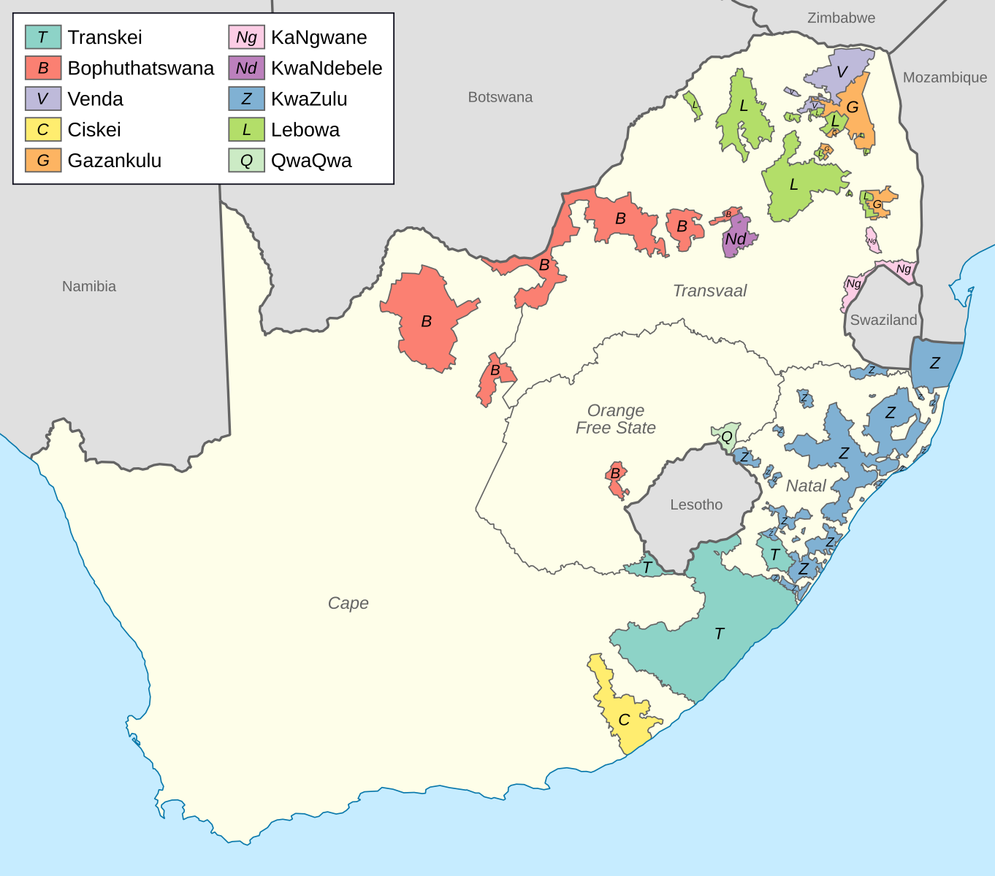
Bantustans
The Bantu Authorities Act (1951) created ten Bantustans (‘homelands’) for Black South Africans to restrict their movement and prevent them from living in areas that the apartheid government had designated for white people, which included many towns and cities.
Bantustans were tied to specific ethnic group identities. Black South Africans were assigned an ethnic identities and corresponding ‘homeland’, even if they did not see this as a central aspect of their identity.
Apartheid laws treated Black South Africans as citizens of their given Bantustan, essentially stripping them of their South African citizenship.
Htonl
Map of Bantustans in South Africa at the end of apartheid (1994)

Slide 15
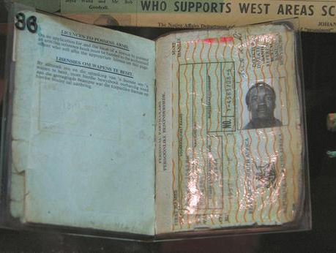
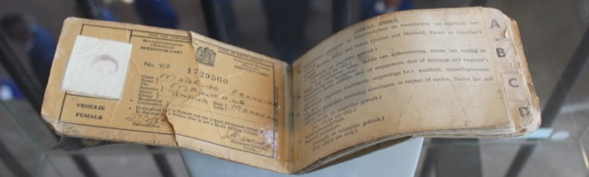
Pass Book (‘Dompas’)
A pass book exhibited as an artefact of apartheid at the Women's Jail, Constitution Hill, Johannesburg
Islahaddow
Phiippa vS
The Pass Laws Act 1952 made it a legal requirement for all black South Africans over the age of 16 to carry a pass outlining their personal information and where they were allowed to travel. Non-white South Africans needed to obtain permission to travel in designated restricted areas, which included most towns and cities. Travelling without a passbook or travelling outside of certain areas without permission was illegal and led to individuals being arrested. While pass laws were not new, this was the first law to apply to all of South Africa.
The nickname for the pass book was the ‘dompas’, which literally means ‘stupid pass’, in Afrikaans.

Slide 16
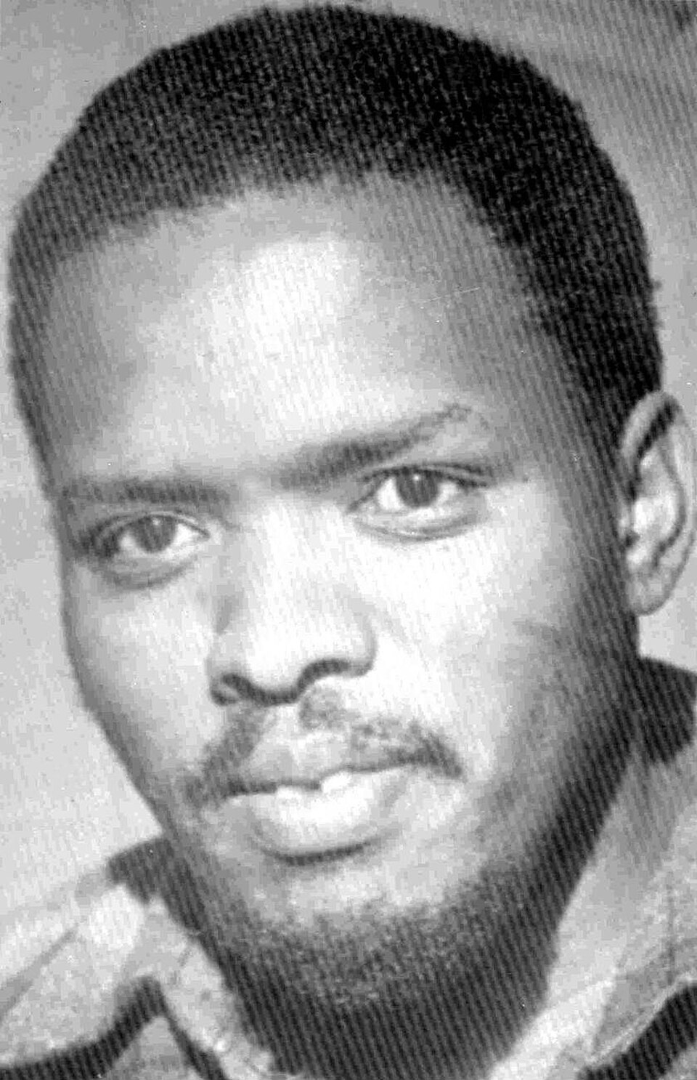
Death of Steve Biko in Police Custody
Steve Biko founded the Black Consciousness Movement, which promoted black pride and psychological liberation from internalised oppression. A large focus of the Black Consciousness philosophy was on Black people defining themselves and taking pride in their identities and cultures, rather than accepting racist white views that placed black people as inferior.
There was also a focus on securing self-sufficiency and self-reliance in black communities, so that they took charge of their education, health and economic opportunities.
Due to Biko’s activism and influence, the apartheid government implemented a repressive banning order in 1973, designed to restrict his travel and social interactions, and stop his activism. This banning order ultimately led to his arrest and murder at the hands of police.
Steve Biko

Slide 17

Reflect on the Lesson
Share one sentence about what you learnt about apartheid in today’s lesson.
Notes:
Finally, ask students to write a one sentence summary of what they learnt in the lesson about apartheid and ask them to share their summaries in a Wraparound.

Slide 18
Extensions

Slide 19
GCSE Style Questions
Describe the ways in which apartheid was shaped by colonialism.
Outline the reasons for the National Party’s victory in 1948.
Describe the key laws of early apartheid.
Describe segregation in South African society.
What do the sources reveal about the experience of people living under apartheid?
Select an apartheid law implemented by the National Party and explain what its purpose was.
Which of the sources is the most useful to a historian studying the impact of living under apartheid?

Slide 20
GCSE Style Questions
Describe ….
Outline …
Use source ____ and your own knowledge to describe the events that / the role of…
Describe the impact of changes in…
Explain why/how…
How useful are the sources for investigating… ?
What was the purpose of… ?
Which of the sources is most useful to a historian studying… ?

Slide 21
A-Level Style Questions
To what extent was apartheid a continuation of earlier colonial systems rather than a new development after 1948?
Assess the reasons for the National Party’s victory in 1948. Which factor was most significant?
How far were economic factors more important than racial ideology in shaping apartheid policy?
What can these sources reveal about the lived experience of apartheid, and what are their limitations as historical evidence?
Assess the reliability and usefulness of visual sources for understanding everyday life under apartheid.
How far do these sources support the view that apartheid controlled all aspects of daily life?
Some historians describe apartheid as a radical break with previous racial policies, while others see it as the culmination of earlier colonial and segregationist practices. Which interpretation is more convincing?

Slide 22
A-Level Style Questions
Assess the relative importance of different factors in shaping…
To what extent was … a turning point?
How far do you agree with the view that…
Assess the significance of…
To what extent does the evidence support the view that…
Assess the strengths and limitations of the sources for understanding…
How useful are the sources for investigating…
Why might historians disagree about…
Which interpretation is more convincing and why?
How and why have interpretations changed over time?

Slide 23
Teach for Tomorrow is an educational charity providing teaching resources to help young people develop as empathetic, critical thinkers, who understand the role they can play in shaping society for the better. Visit www.TeachforTomorrow.org to find out more.
The University of East Anglia is a globally significant centre of research that drives global change. We bring fresh thinking to the major challenges facing society, helping to create a better future for all. Visit www.uea.ac.uk to find out more.
The Anti-Apartheid Legacy Centre promotes the legacy and values of the Southern African liberation struggle and the UK’s central role within this world-changing history, whilst supporting contemporary discourse around social (in)justice, inclusion and multi-racial collaboration for social transformation. Visit www.antiapartheidlegacy.org.uk to find out more.
The National Lottery Heritage Fund is the largest dedicated funder of the UK’s heritage. Its vision is for heritage to be valued, cared for and sustained for everyone, now and in the future. Visit www.heritagefund.org.uk to find out more.

