Slide 1




A Note for Teachers
This presentation is part of a multi-lesson resource on Exploring the Freedom Charter, which was collaboratively developed by Teach for Tomorrow, the Anti-Apartheid Legacy Centre and the University of East Anglia. These educational resources aim to teach students about the Freedom Charter and the context of Apartheid South Africa during its creation, in order to promote the legacy and values of the Southern African liberation struggle, whilst supporting contemporary discourse around social (in)justice, inclusion and multi-racial collaboration for social transformation.
While you may need to modify this presentation to meet the needs of your students, please note that Teach for Tomorrow, the Anti-Apartheid Legacy Trust and the University of East Anglia do not endorse changes that alter the presentation's content or layout.

Slide 2
Lesson Five
Creating a Modern Day Freedom Charter (Part 2)
Exploring the Freedom Charter

Slide 3
Guiding Questions
What are the possible impacts of writing freedom charters?
How has your understanding of freedom and resistance evolved through this learning experience?

Slide 4
Learning Objectives
To write and present a modern day freedom charter.
To be able to evaluate the impact of learning about South Africa’s Freedom Charter.

Slide 5



Reflect on the Modern Day Freedom Charter
Reflect on the following prompts in a journal response:
How has thinking about a modern day freedom charter shaped how you view/engage the world around you?
What does this suggest about the impact of being involved in writing a charter?
How can charter writing be viewed as an act of resistance?
Notes:
Ask students to reflect on the questions before placing them in groups to finish their charter.
Invite students to share their reflections in pairs before leading a short class discussion.

Slide 6

Finish Your Modern Day Freedom Charter
In your groups, finish writing your modern day freedom charter, addressing some of the issues you identified in the first activity.
Collect all your information together, creating:
  A leaflet;
  A PowerPoint presentation;
  An article;
  A poster;
  A speech;
  A poem;
  A piece of theatre;
  Or anything else that comes to mind.
Notes:
Ask students to go into their modern day freedom charter groups to finish writing their charters and to decide how they would like to present it to other students. Presentation options include a leaflet, a PowerPoint presentation, an article, a poster, a speech, a poem, a piece of theatre, or any other method they would like to use.

Slide 7

Reflect on the Modern Day Freedom Charter
Get ready to present your modern day freedom charters to your classmates.
Some guidelines:
Speak clearly
Make eye contact with your students (peers)
Maintain strong and confident body language
Know your topic well
Allow time for questions
Notes:
Give students the opportunity to present their charters to the class.

Slide 8
Reflect on the Learning
Reflect on the following prompts in a journal response:
What is your biggest takeaway from:
  Learning about Apartheid South Africa and the Freedom Charter?
  Writing a modern day freedom charter?
How, if at all, has this learning experience shaped how you view:
  Freedom?
  Resistance to oppression?
Notes:
Finally, ask students to reflect on the following questions before inviting students to share their thoughts in pairs and then with the class.

Slide 9
Extensions

Slide 10

Create a Toolbox for Pathways to Freedom
Create toolbox for pathways to freedom.
Include ideas about what freedom means and looks like that were captured in modern day freedom charters you created and heard, and in South Africa’s Freedom Charter.
john bloor
Notes:
Ask students to create a toolbox for pathways to freedom, including ideas about what freedom means and looks like that were captured in modern day freedom charters they created and heard, and in South Africa’s Freedom Charter.

Slide 11
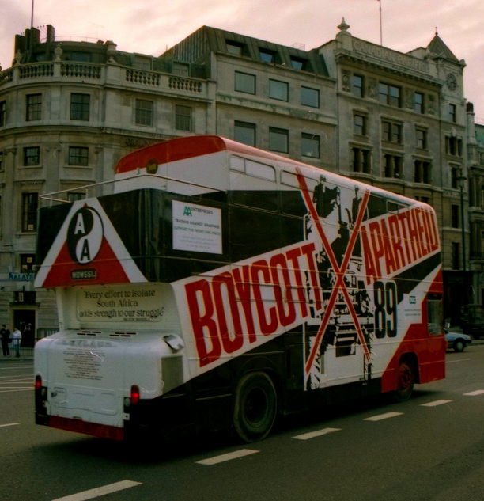
Research the UK’s Anti-Apartheid Movement
Research the UK’s anti-apartheid movement and share your findings in a format of your choice.
As part of this process, reflect on the importance and power of international solidarity in challenging oppression.
You might choose to explore the Anti-Apartheid Movement Archives (https://www.aamarchives.org/) which document the history of the British anti-Apartheid movement.
rahuldlucca
Boycott Apartheid Bus, London, UK
Notes:
Ask students to do research into the UK’s anti-Apartheid movement and to share their findings in a format of their choice. As part of this process, ask them to reflect on the importance and power of international solidarity in challenging oppression. You might choose to share with them the https://www.aamarchives.org/ which document the history of the British anti-Apartheid movement.

Slide 12

Learn about the Dunnes Stores Workers
Read the article When Irish Grocery Workers Stood Against Apartheid.
Notes:
Share the article When Irish Grocery Workers Stood Against Apartheid with students, reading it as a class.

Slide 13
Learn about the Dunnes Stores Workers
Why did the Dunne Stores workers initially go on strike?
How did their understanding of Apartheid evolve after meeting Nimrod Sejake?
  What does this reveal about the power of face to face reactions?
What different ways did people respond to the Dunnes Stores strikers?
  How did these change over time?
What impact did the Dunnes Stores strikes have on how Apartheid was viewed in Ireland (and further afield)?
What do you find surprising, interesting and/or troubling about the Dunnes Stores strikes?
What can the Dunnes Stores strike teach us about the importance and power of international solidarity in standing up against injustice?
Notes:
Then ask students to discuss the questions in groups. You may also wish to share resources created by Ardent Theatre Company related to the play Strike!, which was written about the Dunnes Stores strike.

Slide 14
Share Your Work and Learnings
Share your charters with Teach for Tomorrow and the Anti-Apartheid Legacy Trust and/or write a blogpost or article for these organisations to put on their website.
Notes:
Share your students’ charters with Teach for Tomorrow and the Anti-Apartheid Legacy Trust and/or write a blogpost or article for these organisations to put on their website. Do this by emailing hello@teachfortomorrow.org

Slide 15
GCSE Style Questions
Outline the ideas in the Freedom Charter that relate to economic inequality.
Describe the impact of the Freedom Charter on:
  The struggle against apartheid.
  The anti-apartheid movement.
How do the ideas contained within the Freedom Charter relate to ideas of freedom in the present day?
Which of the sources in the unit is the most useful for a historian studying:
  The experience of those living under apartheid?
  Resistance to apartheid?

Slide 16
GCSE Style Questions
Describe ….
Outline …
Use source ____ and your own knowledge to describe the events that / the role of…
Describe the impact of changes in…
Explain why/how…
How useful are the sources for investigating… ?
What was the purpose of… ?
Which of the sources is most useful to a historian studying… ?

Slide 17
A-Level Style Questions
‘The Freedom Charter marked a turning point in the struggle against apartheid.’ How far do you agree?
‘Economic inequality was the main cause of resistance to apartheid.’ Assess this view.
To what extent was apartheid maintained through coercion rather than consent?
Assess the usefulness of the Freedom Charter as evidence for understanding resistance to apartheid in the 1950s.
How might a historian corroborate the claims and aspirations contained within the Freedom Charter?
How have interpretations of the Freedom Charter changed since 1955?
Why might historians disagree about the Charter’s long-term significance in ending apartheid?

Slide 18
A-Level Style Questions
Assess the relative importance of different factors in shaping…
To what extent was … a turning point?
How far do you agree with the view that…
Assess the significance of…
To what extent does the evidence support the view that…
Assess the strengths and limitations of the sources for understanding…
How useful are the sources for investigating…
Why might historians disagree about…
Which interpretation is more convincing and why?
How and why have interpretations changed over time?

Slide 19
Teach for Tomorrow is an educational charity providing teaching resources to help young people develop as empathetic, critical thinkers, who understand the role they can play in shaping society for the better. Visit www.TeachforTomorrow.org to find out more.
The University of East Anglia is a globally significant centre of research that drives global change. We bring fresh thinking to the major challenges facing society, helping to create a better future for all. Visit www.uea.ac.uk to find out more.
The Anti-Apartheid Legacy Centre promotes the legacy and values of the Southern African liberation struggle and the UK’s central role within this world-changing history, whilst supporting contemporary discourse around social (in)justice, inclusion and multi-racial collaboration for social transformation. Visit www.antiapartheidlegacy.org.uk to find out more.
The National Lottery Heritage Fund is the largest dedicated funder of the UK’s heritage. Its vision is for heritage to be valued, cared for and sustained for everyone, now and in the future. Visit www.heritagefund.org.uk to find out more.

